Slide 1
VHDL Coding Basics

Slide 2
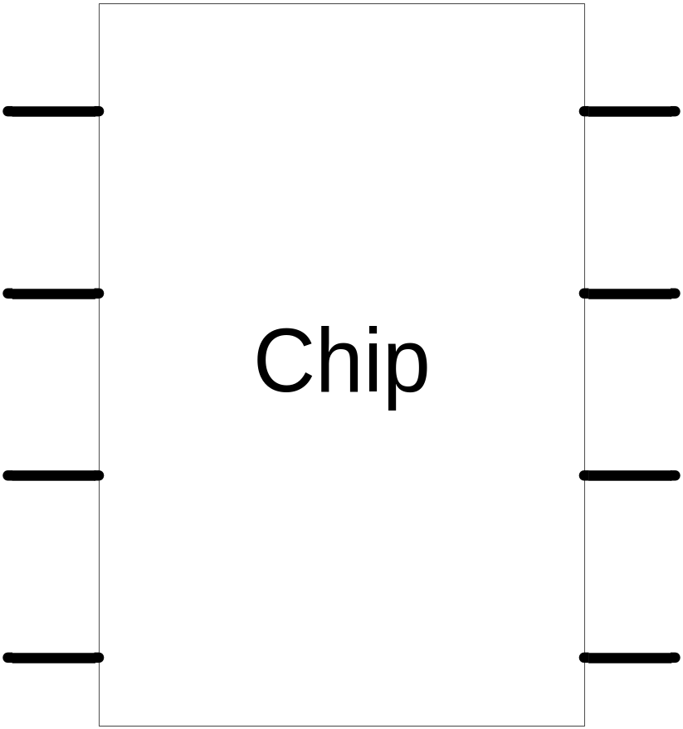
Overview

Slide 3
Libraries
Library ieee;
Use ieee.std_logic_1164.all;
Use ieee.std_logic_arith.all;
Use ieee.std_logic_signed.all;
Use ieee.std_logic_unsigned.all;

Slide 4
Data Types
bit values: '0', '1'
boolean values: TRUE, FALSE
integer values: -(231) to +(231 - 1)
std_logic values: 'U','X','1','0','Z','W','H','L','-'
  U' = uninitialized
  'X' = unknown
  'W' = weak 'X‘
  'Z' = floating
  'H'/'L' = weak '1'/'0‘
  '-' = don't care
Std_logic_vector (n downto 0);
Std_logic_vector (0 upto n);

Slide 5
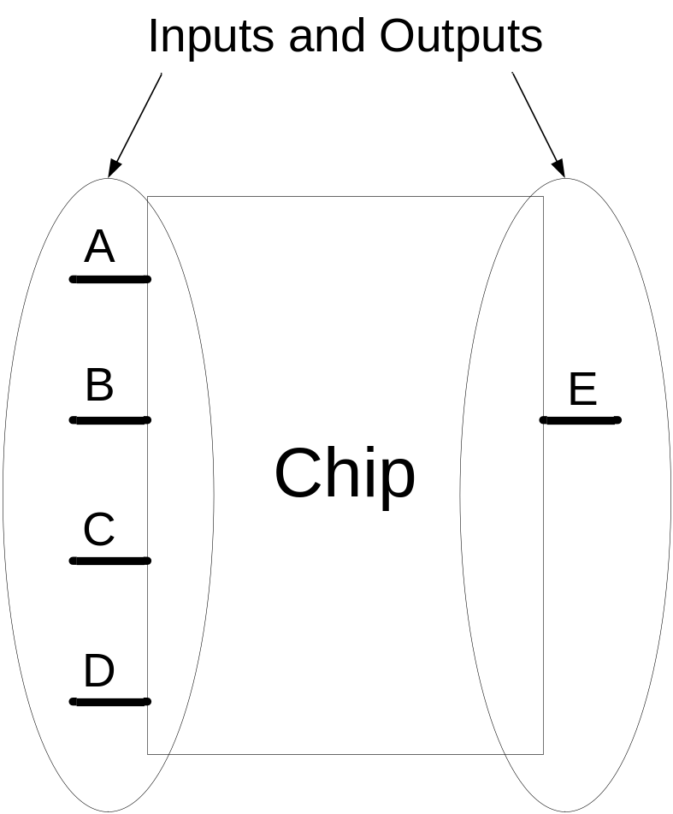
Entity
Define inputs and outputs
Example:
Entity test is
Port( A,B,C,D: in std_logic;
E: out std_logic);
End test;

Slide 6
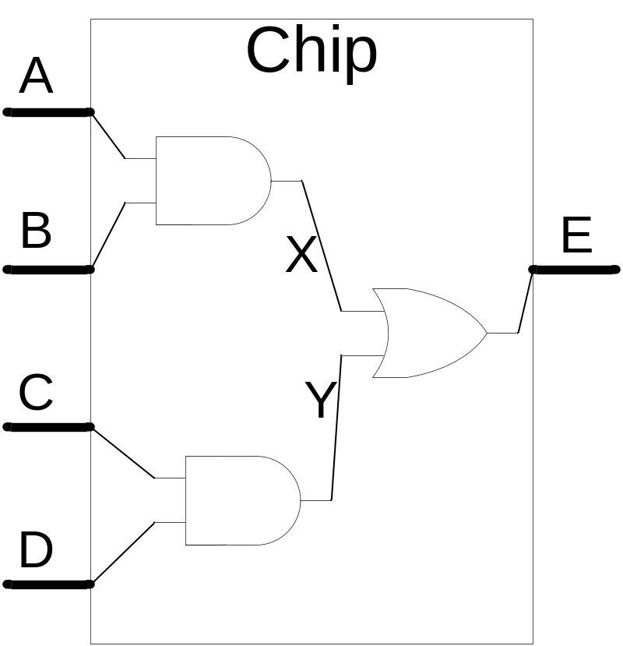
Architecture
Define functionality of the chip
X <= A AND B;
Y <= C AND D;
E <= X OR Y;

Slide 7
VHDL features
Case insensitive
  inputa, INPUTA and InputA are refer to same variable
Comments
  ‘--’ until end of line
  If you want to comment multiple lines, ‘--’ need to be put at the beginning of every single line
Statements are terminated by ‘;’
Signal assignment:
  ‘<=’
User defined names:
  letters, numbers, underscores (‘_’)
  start with a letter

Slide 8
VHDL structure
Library
  Definitions, constants
Entity
  Interface
Architecture
  Implementation, function

Slide 9
VHDL - Library
Include library
library IEEE;
  Define the library package used
use IEEE.STD_LOGIC_1164.all;
  Define the library file used
  For example, STD_LOGIC_1164 defines ‘1’ as logic high and ‘0’ as logic low
    output <= ‘1’; --Assign logic high to output

Slide 10
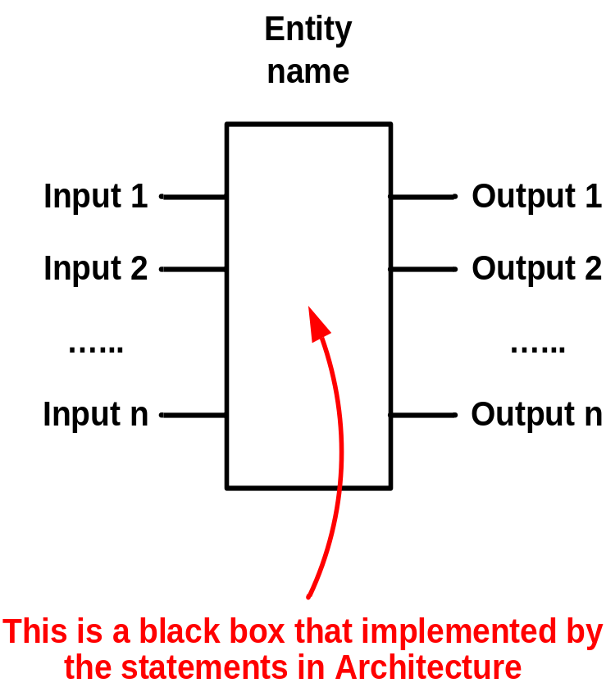
VHDL - Entity
It is the interface for communication among different modules / components and define the signal port modes (INPUT and OUTPUT)

Slide 11
VHDL - Entity
Define INPUT, OUTPUT Port
entity test7 is
port ( inputa : in std_logic;
inputb : in std_logic;
output : out std_logic
);
end test7;
DO NOT have ; here
Entity name should be same as the file name

Slide 12
VHDL - Entity
Input port can only be read inside architecture
  input1 <= temp; -- This statement is NOT allowed
Output port can only be written inside architecture
  temp <= output1; -- This statement is NOT allowed

Slide 13
Design using VHDL
Define the logic function
output <= inputa and inputb;
output is assigned to be inputa AND inputb
LHS contains only 1 variable only
RHS can be logics operations for many variables

Slide 14
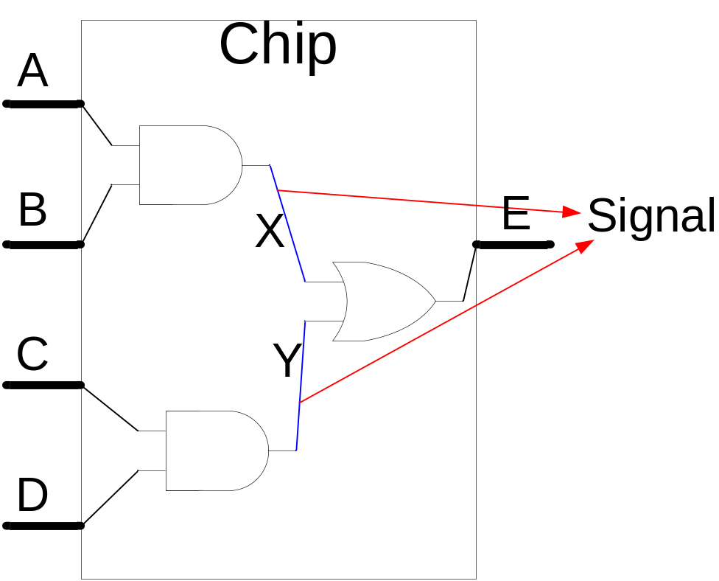
Signal
All internal variables
Signal X,Y : std_logic;

Slide 15
Final code
LIBRARY IEEE;
USE IEEE.STD_LOGIC_1164.ALL;
ENTITY TEST IS
PORT (A,B,C,D : IN STD_LOGIC;
E : OUT STD_LOGIC);
END TEST;
ARCHITECTURE BEHAVIOR OF TEST IS
SIGNAL X,Y : STD_LOGIC;
BEGIN
X <= (not A) AND B;
Y <= C AND D;
E <= X OR Y;
END BEHAVIOR;

Slide 16
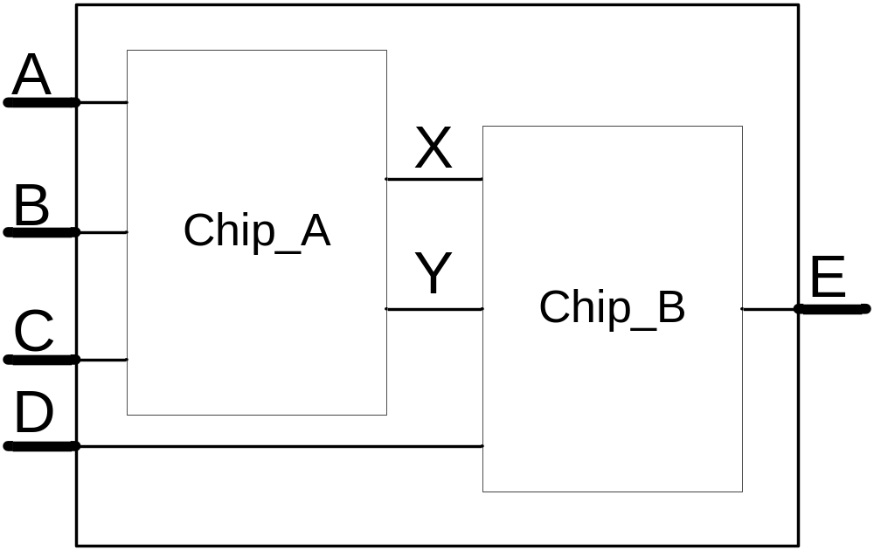
Port Map
Chip1 : Chip_A
Port map (A,B,C,X,Y);
Chip2 : Chip_B
Port map (X,Y,D,E);

Slide 17
Final code
LIBRARY IEEE;
USE IEEE.STD_LOGIC_1164.ALL;
ENTITY TEST IS
PORT (A,B,C,D : IN STD_LOGIC;
E : OUT STD_LOGIC);
END TEST;
ARCHITECTURE BEHAVIOR OF TEST IS
SIGNAL X,Y : STD_LOGIC;
COMPONENT Chip_A
PORT (L,M,N : IN STD_LOGIC;
O,P : OUT STD_LOGIC);
END COMPONENT;
COMPONENT Chip_B
PORT (Q,R,S : IN STD_LOGIC;
T : OUT STD_LOGIC);
END COMPONENT;
BEGIN
Chip1 : Chip_A
PORT MAP (A,B,C,X,Y);
Chip2 : Chip_B
PORT MAP (X,Y,D,E);
END BEHAVIOR;

Slide 18
Process
All statements in a process occur sequentially
If statements are defined in a process statement
Processes have sensitivity list
Process (A,B,C)
Begin
instructions
End process;

Slide 19
If Statement
If condition then
  sequence_of_statements
End if;
If condition then
  sequence_of_statements
Elsif condition then
  sequence_of_statements
End if;
Example
If A = ‘0’ then
C<=B;
End if;
If A = ‘0’ then
C<=B;
Elsif A = ‘1’ then
C<=A;
End if;

Slide 20
VHDL language elements
VHDL is composed of language building blocks that consist of more than 75 reserved words and about 200 descriptive words or word combinations
Notes:
1

Slide 21
Reserved VHDL keywords
ABS
ACCESS
AFTER
ALIAS
ALL
AND
ARCHITECTURE
ARRAY
ASSERT
ATTRIBUTE
BEGIN
BLOCK
BODY
BUFFER
BUS
CASE
COMPONENT
CONFIGURATION CONSTANT
DISCONNECT
DOWNTO
ELSE
ELSIF
END
ENTITY
EXIT
FILE
FOR
FUNCTION
GENERATE
GENERIC
GROUP
GUARDED
IF
IMPURE
IN
INERTIAL
INOUT
IS
LABEL
LIBRARY
LINKAGE
LITERAL
LOOP
MAP
MOD
NAND
NEW
NEXT
NOR
NOT
NULL
OF
ON
OPEN
OR
OTHERS
OUT
PACKAGE
PORT
POSTPONED
PROCEDURE
PROCESS
PURE
RANGE
RECORD
REGISTER
REM
REPORT
ROL
ROR
RETURN
SELECT
SEVERITY
SIGNAL
SHARED
SLA
SLL
SRA
SRL
SUBTYPE
THEN
TO
TRANSPORT
TYPE
UNAFFECTED
UNITS
UNTIL
USE
VARIABLE
WAIT
WHEN
WHILE
WITH
XNOR
XOR
Notes:
3

Slide 22
Design Description Methods
Structural Description Method
Behavioral Description Method
Data-Flow Description Method
These two are similar in that both use a process to describe the functionality of a circuit
Schematic
Notes:
9

Slide 23
VHDL language abstractions
VHDL is rich in language abstractions, in addition to which the language can be used to describe different abstraction levels, from functions right down to a gate description
Abstraction levels are a means of concealing details

Slide 24
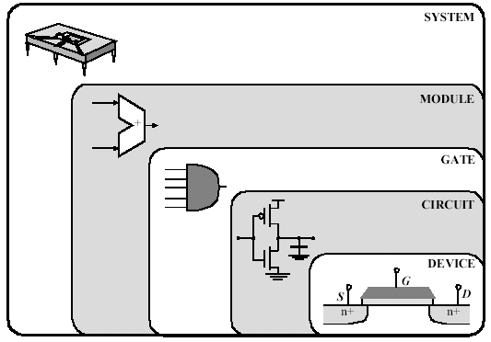
Abstraction (and complexity) levels
Functional (system) level + architecture =>
Behavioral level + resource handler =>
RTL (Structural) level + technology data =>
Logic (gate) level + electrical specification =>
Electrical level + layout requirements =>
Layout level
Our main topics

Slide 25
Definitions of the Description Methods
Structural Description Method: expresses the design as an arrangement of interconnected components
  It is basically schematic
Behavioral Description Method: describes the functional behavior of a hardware design in terms of circuits and signal responses to various stimuli
  The hardware behavior is described algorithmically
Data-Flow Description Method: is similar to a register-transfer language
  This method describes the function of a design by defining the flow of information from one input or register to another register or output
Notes:
10

Slide 26
Functional (system) level
Algorithms can be describe at this level
E.g. a controller algorithm can be described and simulated on the computer
An algorithm does not need to contain any time information
Specifications written in VHDL will be able to be simulated

Slide 27
Behavioral level
Behavior and time are described at this level
No architecture is required here
The advantage of models at this level is that models for simulation can be built quickly
A behavioral model can be described as functional modules and an interface between them
The modules contain one or more functions and time relations
In certain cases the architecture can be defined

Slide 28
A Behavioral Description uses a small number of processes where each process performs a number of sequential signal assignments to multiple signals
In contrast, a Data-Flow Description uses a large number of concurrent signal assignment statements
A concurrent statement executes asynchronously with respect to other concurrent statements
Concurrent statements used in Data-Flow Description include:
- block statement (used to group one or more concurrent statements)
- concurrent procedure call
- concurrent assertion statement
- concurrent signal assignment statement
Comparing the Description Methods
Notes:
11

Slide 29
RTL = Register Transfer Level
It consists of a language which describes behavior in
  asynchronous and synchronous state machines
  data paths
  operators (+,*,<,>,...)
  registers

Slide 30
Electrical level
Other name is: transistor level
There are models of
  transistors
  capacitances
  resistances
This is not supported in VHDL

Slide 31
Layout level
At layout level models are made of the physical process
This is not supported in VHDL

Slide 32
Synthesis = Increasing Complexity
Synthesis is done between each level
The volume of information increases between the various abstraction levels
  E.g. technology information is required to synthesize from RT to gate level
  Each transition (synthesis) generates more information
In order to implement a function in an ASIC, are required the followings:
  technology information
  wiring information
  gate information
  set-up times

Slide 33
Why are different abstraction levels used?
It is usually the requirements that determine the abstraction level at which the information is to be described
If a short development time is required, a high abstraction level should be chosen as the description language
In practice RT level (and parts of behavioral) can be synthesized automatically to gate level

Slide 34
Different applications
ASIC = Application Specific Integrated Circuit
  Usually includes FPGA, gate array, standard cell and full custom designs.
PCB = Printed Circuit Board design
  On a circuit board there are usually several ASICs together with a microprocessor and its infrastructure
System = a number of PCBs

Slide 35
Model evaluation
The code for VHDL component can be verified functionally in a simulator
The simulator simulates (“executes”) the VHDL code with input signals and produces a signal diagram and error messages on the basis of the components
The input signals are defined either in VHDL or in the simulator’s language
When the VHDL code is simulated, functional verification takes place
At a later stage, time verification of the design is also possible

Slide 36
Simulation
Simulating models is an effective way of verifying the design
The model in the computer is only a time-discrete model, however, while reality is continuous
The computer model is more or less like reality
It is least like reality at a high abstraction level (behavioral) and most like it at the lowest level (layout)

Slide 37
Other languages for describing electronics
There are several languages which are used to describe electronic designs
One popular language is called VERILOG
It is used from RT level down
In some other languages there are no hierarchies, which causes major problems when working on complex assignments
There languages are developed by universities and research centers

Slide 38
Mechanisms by which to reduce complexity
Language abstractions use the language to describe complex matters without having to describe small details
  Functions and procedures are important parts of the language in order to handle complexity
Design hierarchy uses components in order to conceal details - the black box principle
  The term black box means that only inputs/outputs of a component are visible at a certain level
  It is the designer who decides how many different hierarchies there are to be in the design

Slide 39
Key feature: delta delay
VHDL uses the concept of delta delay to keep track of processes that should occur at a given time step, but are actually evaluated in different machine cycles
A delta delay is a unit of time as far as the simulator hardware is concerned, but in the simulation itself time has no advance
Notes:
14

Slide 40
VHDL component
Components are a central concept in VHDL
Components are used, among other things, to build up component libraries, e.g.:
  microprocessors
  special user circuits
  other standard circuits
If a “good” component has been designed, it can be saved in a component library, enabling it to be copied as many times as required, i.e. components are reusable
  this is called creating instances, i.e. creating the component in a schematic or in the text file

Slide 41
Object-based language
Staying with computer science a while longer, VHDL is an object-based language, i.e. what separates VHDL from object-oriented languages is that the language does not have inheritance
Generic components and instantiation are typical for object-based languages
Generic components are components which can be modified before instantiation, e.g. a generic component which copes with different width for the input and output signals

Slide 42
Using the black box
The internal structure can be concealed from the designer - the black box principle
In some cases there is no need to know how to component is structured
The designer is usually only interested in
  inputs and outputs
  a specification function and
  access times
The majority of hardware designers are used to working with black boxes such as the 74LSXX circuit family, for example

Slide 43
Major Language Constructs
- design entity: It is the basic unit of hardware description
- architecture: It describes the relationship between the design entity inputs and outputs
Each architecture consists of concurrent statements denoted by CS
Notes:
4

Slide 44
Concurrent statements define interconnected processes and blocks that together describe a design’s overall behavior or structure
They can be grouped using block statement. Groups of blocks can also be partitioned into other blocks
At this same level, a VHDL component can be connected to define signals within the blocks
It is a reference to an entity
A process can be a single signal assignment statement or a series of sequential statements (SS)
Within a process, procedures and functions can partition the sequential statements
Concurrent & Sequential Statements
Notes:
5

Slide 45
Primary Language Abstraction
The primary abstraction level of a VHDL hardware model is the Design Entity. The Design Entity can represent a cell, chip, board, or subsystem
Design Entity
Entity Declaration
Architecture
A Design Entity is composed of two main parts:
1) An Entity Declaration
2) An Architecture
Notes:
6

Slide 46
An Entity Declaration defines the interface between the Design Entity and the environment outside of the Design Entity
An Architecture describes the relationships between the Design Entity inputs and outputs
Primary Language Abstraction (cont.)
Notes:
7

Slide 47
ENTITY and2 IS
PORT (a, b: IN bit; q: OUT bit);
END and2;
ARCHITECTURE example OF and2 IS
-- declaration here
BEGIN
-- statement here
END example;
Example of Entity Declaration and Architecture
The entity name in the Architecture has to be the same as the identifier of the corresponding Entity Declaration
Notes:
8

Slide 48
Entity declaration and architecture
A component is made up of two main parts:
  Entity declaration: Port declaration for inputs and outputs
  Architecture: structural of behavioural description
Behaviour is defined as a collective name for functions, operations, behaviour and relations
Behaviour can also be a structural description, i.e. the component consists of other components
The entity can be regarded as a black box with inputs and outputs

Slide 49
Example code of an entity
  Entity VHDL_COMPONENT is
  port ( A : in std_logic;
  B : out std_logic);
  end VHDL_COMPONENT;

Slide 50
Example code of an architecture
  Architecture VHDL_CODE of VHDL_COMPONENT is
  begin
  B <= not A;
  ....
  end VHDL_CODE;
Two names are specified in the architecture declaration: the component name which describes which entity the architecture belongs to, and vhdl_code, which is the name of the architecture

Slide 51
Entity and Component
An entity declaration defines the interface between an entity and the environment in which it is used
The entity name is the same as the component name

Slide 52
Syntax of the entity declaration
entity <identifier_name> is
port( [signal] <identifier>:[<mode>] <type_indication>;
...
[signal] <identifier>:[<mode>] <type_indication>);
end [entity] [<identifier_name>];

Slide 53
The mode of the port
<mode> = in, out, inout, buffer, linkage
in: Component only read the signal
out: Component only write to the signal
inout: Component read or write to the signal (bidirectional signals)
buffer: Component write and read back the signal (no bidirectional signals, the signal is going out from the component)
linkage: Used only in the documentation

Slide 54
Example of a VHDL Component
entity vhdl_component is
port( signal a_in: in std_logic; -- input
signal b_out: out std_logic); -- output
end vhdl_component;

Slide 55
Inout or Buffer
Mode inout should only be used in the case of bidirectional signals
If the signal has to be reread, either mode buffer or an internal dummy signal should be used
The word signal is normally left out of the port declaration, as it does not add any information
Mode in and the name of the entity after end can also be left out

Slide 56
Example for simplification
entity gate1 is
port( signal a,b: in std_logic;
signal c: out std_logic);
end gate1;
entity gate1 is -- Identical with the above example
port( a,b: std_logic;
c: out std_logic);
end;

Slide 57
Architecture
An architecture defines a body for a component entity
An architecture body specifies a behavior between inputs and outputs
The architecture name is not the same as the component name: instead an architecture is tied to an entity

Slide 58
Syntax of the Architecture
architecture <architecture_name> of <entity_identifier> is
[<architecture_declarative_part>]
begin
<architecture_statement_part> -- The body of the arch.
end [architecture] [<architecture_name>];
The word “architecture” in the last line is not supported before the VHDL-93 standard

Slide 59
Remarks
The architecture declaration part must be defined before first begin and can consist of, for example:
  types
  subprograms
  components
  signal declarations

Slide 60
The architecture of an inverter
architecture dtf of cir is
begin
b_out <= not a_in;
end dtf;

Slide 61
Important Remarks
An entity can be linked to several architectures such as behavioral and RTL descriptions, for example
Note that VHDL does not differentiate between upper-case and lower-case letters
The double dash “--” indicates that the rest of the line is commentary

Slide 62
Logical operators defined in VHDL
NOT
AND
NAND
OR
NOR
XOR
EXOR

Slide 63
Example
architecture rtl of cir is
signal int: std_logic; -- Internal signal declaration
begin
int <= not (((a nand b) nor (c or d)) xor e);
A_OUT <= int and f;
end;

Slide 64
Comments
Comments follow two hyphens '--' and instruct the analyzer to ignore the rest of the line
There are no multiline comments in VHDL
Tabs improve readability, but it is best not to rely on a tab as a space in case the tabs are lost or deleted in conversion
You should thus write code that is still legal if all tabs are deleted (use spaces as tabs!)

Slide 65
Literals, i.e. fixed-valued items
There are various forms of literals in VHDL. The following code shows some examples:
entity Literals_1 is end;
architecture Behave of Literals_1 is
begin process
variable I1 : integer;
variable R1 : real;
variable C1 : CHARACTER;
variable S16 : STRING(1 to 16);
variable BV4 : BIT_VECTOR(0 to 3);
variable BV12 : BIT_VECTOR(0 to 11);
variable BV16 : BIT_VECTOR(0 to 15);

Slide 66
Literals (contd.)
begin
-- Abstract literals are decimal or based literals
-- Decimal literals are integer or real literals
-- Integer literal examples (each of these is the same):
I1 := 120000; I1 := 12e4; I1 := 120_000;
-- Based literal examples (each of these is the same):
I1 := 2#1111_1111#; I1 := 16#FF#;
-- Base must be an integer from 2 to 16:
I1 := 16:FFFF:; -- you may use a : instead of #
-- Real literal examples (each of these is the same):
R1 := 120000.0; R1 := 1.2e5; R1 := 12.0E4;
-- Character literal must be one of the 191 graphic characters
-- 65 of the 256 ISO Latin-1 set are non-printing control
-- characters
C1 := 'A'; C1 := 'a'; -- these are different!

Slide 67
Literals (contd.)
-- String literal examples:
S16 := " string" & " literal"; -- concatenate long strings
S16 := """Hello,"" I said!"; -- doubled quotes
S16 := %string literal%; -- can use % instead of "
S16 := %Sale: 50%% off!!!%; -- doubled %
-- Bit-string literal examples:
BV4 := B"1100"; -- binary bit-string literal
BV12 := O"7777"; -- octal bit-string literal
BV16 := X"FFFF"; -- hex bit-string literal
wait;
end process; -- the wait prevents an endless loop
end;

Slide 68
Example: two inputs and an output
entity Half_Adder is
port (X, Y : in BIT := '0'; Sum, Cout : out BIT); -- formals
end;
  Matching the parts of this code with the constructs you can see that the identifier is Half_Adder and that
  X, Y: in BIT := '0'; Sum, Cout: out BIT
  corresponds to
  port_interface_list
  The ports X, Y, Sum, and Cout are formal ports, or formals
  This particular entity Half_Adder does not use any of the other optional constructs that are legal in an entity declaration

Slide 69
Example
The following architecture body (we shall just call it an architecture from now on) describes the contents of the entity Half_Adder :
architecture Dtf of Half_Adder is
begin
Sum <= X xor Y;
Cout <= X and Y;
end Dtf;

Slide 70
Architecture (contd.)
We use the same signal names, the formals: Sum , X , Y , and Cout, in the architecture as we use in the entity
  we say the signals of the "parent" entity are visible inside the architecture "child"
An architecture can refer to other entity-architecture pairs (i.e., we can nest black boxes)
We shall often refer to an entity-architecture pair as entity(architecture)
For example, the architecture Behave of the entity Half_Adder is Half_Adder(Behave)

Slide 71
Architecture (contd.)
Q: Why would we want to describe the outside
of a black box (an entity) separately from the
description of its contents (its architecture)?
A: Separating the two makes it easier to move
between different architectures for an entity
(there must be at least one).
For example, one architecture may model an
entity at a behavioral level, while another
architecture may be a structural model.

Slide 72
Component declaration (again)
A structural model that uses an entity in an architecture must
  declare that entity
  its interface
Use a component declaration:
component_declaration ::=
component identifier [is]
[generic (local_generic_interface_list);]
[port (local_port_interface_list);]
end component [component_identifier];

Slide 73
Structural version …
architecture Netlist of Half_Adder is
-- component with locals
component MyXor port (A_Xor,B_Xor : in BIT; Z_Xor : out BIT);
end component;
-- component with locals
component MyAnd port (A_And,B_And : in BIT; Z_And : out BIT);
end component;
begin
Xor1: MyXor port map (X, Y, Sum);
-- instance with actuals
And1 : MyAnd port map (X, Y, Cout);
-- instance with actuals
end;

Slide 74
Structural version (contd.)
We declare the components: MyAnd, MyXor and their local ports (or locals):
A_Xor, B_Xor, Z_Xor, A_And, B_And, Z_And
We instantiate the components with instance names:
And1 and Xor1
We connect instances using actual ports (or actuals):
X, Y , Sum, Cout
Next we define the entities and architectures that we shall use for the components MyAnd and MyXor
An entity-architecture pair (and its formal ports) is like a data-book specification for a logic cell: the component (and its local ports) corresponds to a software model for the logic cell, and an instance (and its actual ports) is the logic cell

Slide 75
Structural version (contd.)
We do not need to write VHDL code for MyAnd and MyXor because the code is provided as a technology library (also called an ASIC vendor library because it is often sold or distributed by the ASIC company that will manufacture the chip, and not by the software company)
entity AndGate is
port(And_in_1, And_in_2: in BIT; And_out: out BIT); -- formals
end;
architecture Simple of AndGate is
begin And_out <= And_in_1 and And_in_2;
end;
entity XorGate is
port (Xor_in_1, Xor_in_2: in BIT; Xor_out: out BIT); -- formals
end;
architecture Simple of XorGate is
begin Xor_out <= Xor_in_1 xor Xor_in_2;
end;

Slide 76
Configuration (again)
If we keep the description of a circuit’s interface (the entity) separate from its contents (the architecture), we need a way to link or bind them together
A configuration declaration binds entities and architectures
configuration_declaration ::=
configuration identifier of entity_name is
{use_clause | attribute_specification
| group_declaration}
block_configuration
end [configuration] [configuration_identifier];

Slide 77
Entity-architecture pair (again)
An entity-architecture pair is a design entity
A configuration declaration
  defines which design entities we wish to use
  associates the formal ports
  (from the entity declaration)
  with the local ports
  (from the component declaration)

Slide 78
Configuration of the HA
configuration Simplest of Half_Adder is
use work.all;
for Netlist
for And1: MyAnd use entity AndGate(Simple)
port map -- formals => locals
(And_in_1 => A_And,
And_in_2 => B_And,
And_out => Z_And);
end for;
for Xor1: MyXor use entity XorGate(Simple)
port map -- formals => locals
(Xor_in_1 => A_Xor,
Xor_in_2 => B_Xor,
Xor_out => Z_Xor);
end for;
end for;
end;

Slide 79
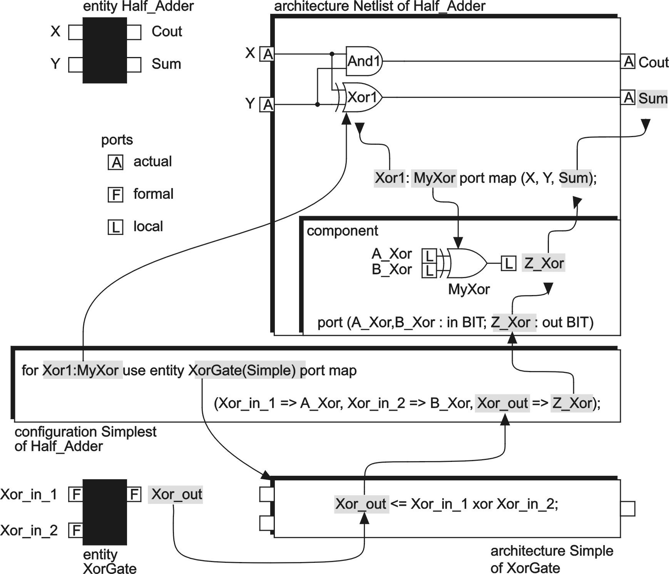
Remember

Slide 80
Explanations
The figure seems complicated, but there are two reasons that VHDL works this way
  Separating the entity, architecture, component, and configuration makes it easier to reuse code and change libraries
  (all we have to do is change names in the port maps and configuration declaration)
  We only have to alter and reanalyze the configuration declaration to change which architectures we use in a model--giving us a fast debug cycle

Slide 81
Explanations (contd.)
One can think of design units and the analyzed entity-architecture pairs, as compiled object-code modules
The configuration then determines which object-code modules are linked together to form an executable binary code
One may also think about …
  entity as a block diagram
  architecture (for an entity) as a more detailed circuit
  schematic for the block diagram
  configuration as a parts list of the circuit
  components with their part
  numbers and manufacturers
  Also known as a BOM for bill of materials (most manufacturers use schematics and BOMs as control documents for electronic systems)
This is part of the rationale behind the structure (of VHDL)

Slide 82
An HDL is a high level language (similar to C, Pascal, Fortran, etc)
used to specify the design of electronic circuits.
With modern programmable hardware (i.e. configuring bit strings
can be sent into a programmable chip to tell the chip how to wire
itself up (i.e. to configure itself).
Modern hardware compilers can take a high level description of an
electronic circuit (e.g. written in an HDL such as VHDL, or Verilog,
or ABEL, etc), and translate it into configuring bit strings, which are
then used to configure a programmble chip (e.g. Xilinx’s Virtex chip).
Thanks to Moore’s Law, the number of programmable logic gates (e.g.
AND gates, NAND gates, etc) in today’s chips are now in the millions.
With such electronic capacities on a single chip, it is now possible to
place whole electronic systems on a chip.

Slide 83
This has advantages and disadvantages. The advantage is that
Electronics become more sophisticated and powerful and cheaper.
The disadvantage is that electronics becomes harder to design.
Earlier versions of HDLs operated more at the gate level of
description (e.g. “connect the output of gate A to the input of
gate B”).
But, as chips increased in their logic gate count, the above rather low
level of description became increasingly impractical due to the huge
number of gates on a single chip.
To cope with this problem, HDLs are taking an ever more behavioral
level of description. Electronic designers nowadays give a behavioral
or functional description of what they want their circuit to perform,
and the HDL compiler does the rest.

Slide 84
e.g. instead of saying “connect this gate to that gate”, one says
“multiply these two numbers and store the result in this buffer”.
The HDL compiler then translates the latter statement into the
Corresponding circuitry that performs the required function.
Nowadays, it is almost as easy to program hardware as to program
software!
This is not strictly true, since to be able to use an HDL well, one needs
to understand the principles of digital electronic design (e.g.
multiplexors, flip-flops, buffers, counters, etc).
But, increasingly, hardware design is becoming more like programming
in a high level software language, like “C”.
We will have a lot more to say about programming in an HDL.

Slide 85
But we now know enough about the basic idea of an HDL to answer
the question of the relevance of HDLs to brain building.
If one wants to build artificial brains with hundreds/thousands and
more of evolved neural net circuit modules, then the speed of
evolution of those modules and the speed of the neural signaling of
the interconnected brain comprised of those evolved modules, is
paramount.
It is well known that hardware speeds are typically hundreds to
thousands of times faster than software speeds on the same task.
As Moore’s law creates chips with millions and later billions of
logic gates on a single chip, it will become increasingly possible to
put artificial brain technology into them.
Today’s programmable chips contain about ten million gates (10⁷)

Slide 86
This is already enough to start putting tens of modules together to
build simple artificial brains in a single chip.
By placing dozens of chips on an electronic board (not cheap!)
Then the size of the brain scales linearly with the number of chips.
People who want to be trained in the principles of brain building
technology therefore need to know how to put their brain designs
into hardware, so that they can both evolve their component
modules and run them once they are interconnected.
Therefore, the next block of lectures will be concerned with the
details of VHDL.
If you have not already had a course in basic digital electronic
hardware design, then you will need to quickly teach yourself
these skills, because these lectures assume that knowledge.

Slide 87
VHDL
VHDL is a Hardware Description Language.
Ovedr the years, HDLs have evolved to help electronic designers
in the following tasks -
a) Describing digital systems
b) Modeling digital systems
c) Designing digital systems
The VHDL language can be used with several goals in mind -
i) To synthesize digital circuits
ii) To verify and validate digital designs
iii) To generate test vectors to test circuits
iv) To simulate circuits

Slide 88
VHDL can be a useful means to simulate the building blocks used
in digital logic and computer architecture courses.
The most effective way to learn about digital systems is to build
them.With VHDL, these systems can be simulated.
The size of simulated systems can be larger than playing with real
digital components.

Slide 89
Basic Language Concepts
Digital systems are fundamentally about signals.
Signals can take on 3 different values, 0, 1, or z (high impedance).
Signals are analogous to wires used to connect components of a
digital circuit.
VHDL has a signal object type. They can be assigned values.
They can have an assigned time value (since a signal takes a value
at a particular time).
A signal keeps its value until assigned a new one later in time.
Think of a signal as a set of time-value pairs. Each pair represents
some future value of the signal.

Slide 90
e.g. we can model the output of an ALU an an integer value.
The output can be treated as a signal and behaves as a signal by
receiving values at specific points in time.
However, we don’t have to concern ourselves with the number of
bits necessary at the output of the ALU.
We can model systems at a higher level of abstraction than digital
circuits. This is useful in the early stages of circuit design, when
many details of the design are still being developed.
Entity-Architecture
How to describe digital systems? (HDL = HW Description Language)

Slide 91
The primary programming abstraction in VHDL is the design entity.
A design entity can be e.g. a chip, board, transistor.
It is a component of a design, whose behavior is to be described
and simulated.
Concrete example, to get the idea -
Take the case of a half adder (see figure).
a
XOR
sum
b
A Half-Adder Circuit
&
carry

Slide 92
There are 2 in input signals a and b . The circuit computes the
values of 2 output signals sum and carry.
The half adder is an example of a design entity.
How to describe accurately the half adder?
There are 2 basic components to the description of a design entity -
a) The external interface to the design
b) The internal behavior of the design
VHDL provides 2 distinct constructs to specify the external interface
and the internal behavior of design entities, respectively.
a) For the external interface VHDL specifies the entity declaration.
b) For the internal behavior VHDL specifies the architecture declaration

Slide 93
For the half adder, the entity declaration would be -
entity half_adder is
port(a,b: in bit;
sum, carry: out bit);
end half_adder;
The highlighted (bold face) words are key words in VHDL.
The other words are user given.
The label half_adder is given to this design entity by the programmer.
Note, VHDL is case INsensitive.
The inputs and outputs of the circuits are called PORTS.
Ports are special programming objects and are signals.

Slide 94
Ports are the means used by the circuit to communicate with the
external world, or to other circuits.
Each port, i.e. a signal, must be declared to be of a particular type.
Here, each port is declared to be of type bit, and represents a single
bit signal.
A bit is a signal type defined within VHDL and take values 0 or 1.
A bit_vector is a signal type consisting of a vector of signals, each
of type bit.
Bit and bit_vector are two common types of ports.
Other port data types are possible (later!)
Bits and bit_vectors are fundamental signals in digital design.

Slide 95
There is an IEEE 1164 Standard gaining in popularity. In it, instead
of bit, the term std_ulogic is used.
Similarly, instead of bit_vector, std_ulogic_vector.
From now on, we use the IEEE standard notation (and data types).
Hence we can rewrite the former entity declaration as -
entity half_adder is
port(a,b: in std_ulogic;
sum, carry: out std_ulogic);
end half_adder;
Signals at a port can be classified as -
a) Input signals
b) Output signals
c) Bi-directional signals

Slide 96
These 3 kinds are called the mode of the signal.
Bi-directional signals have the inout mode.
Every port in the entity description must have its mode and type
specified.
Writing entity descriptions is fairly straightforward, e.g.
I0
entity mux is
port (I0, I1 :in std_ulogic_vector (7 downto 0);
I2, I3 : in std_ulogic_vector (7 downto 0);
Sel : in std_ulogic_vector (1 downto 0);
Z :out std_ulogic_vector (7 downto 0));
end mux;
M
U
X
I1
Z
I2
I3
Sel
Entity Declaration of a 4-to-1 Multiplexor

Slide 97
R
entity D_ff is
port(D, Clk, R, S :in std_ulogic;
Q, Qbar :out std_ulogic);
end D_ff;
D
Q
Clk
Q
Entity declaration of a D Flip-flop
S
A
B
entity ALU32 is
port(A,B :in std_ulogic_vector (31 downto 0);
C : out std_ulogic_vector (31 downto 0);
Op : in std_ulogic_vector (5 downto 0);
N, Z : out std_ulogic);
end ALU32;
Op
N
Z
C
Entity Declaration of a 32-bit ALU

Slide 98
From the above examples, it is clear that design entities can occur
at multiple levels of abstraction, from gate level to large systems.
A design entity doesn’t even have to be of digital hardware.
A description of the external interface is a specification of the input
and output signals of the design entity.
Internal Behavior
Once the interface to the digital component or circuit is described,
the next thing is to describe its internal behavior.
The VHDL construct used to describe an entity’s internal behavior
is the architecture, whose syntax takes the general form of -

Slide 99
architecture behavioral of half_adder is
-- place declarations here
begin
-- place description of behavior here --
end behavioral;
The above construct gives the declaration of the module named
behavioral that contains the description of the behavior of the
design entity named half_adder.
Such a module is referred to as the architecture and is associated
with the entity named in the declaration.
Hence the description of a design takes the form of an
entity-architecture pair.

Slide 100
The architecture description is linked to the correct entity description
by giving the name of the corresponding entity in the 1st line
of the architecture.
The behavioral description in the architecture can take many forms.
They differ in -
a) Levels of detail
b) Description of events
c) Degree of concurrency
Concurrent Statements
Electronics is inherently concurrent (i.e. many things happen at the
same time), e.g. many components driving signals to new values.

Slide 101
How to describe the assignment of values to signals?
Signal values are time-value pairs (i.e. a signal is assigned a value
at a particular time).
VHDL assigns values to signals using signal assignment statements.
These statements specify a new value of a signal and the time at
which the signal is to acquire this new value.
Multiple signal assignment statements are executed concurrently in
simulated time.
These are called -
Concurrent Signal Assignment statements (CSAs).
There are various types of CSAs.

Slide 102
Simple Concurrent Signal Assignment
Consider the description of the behavior of the half-adder circuit.
We need to be able to specify events, delays, and concurrency
of operation of this circuit, e.g. in VHDL -
architecture concurrent_behavior of half_adder is
begin
sum <= (a xor b) after 5 ns;
carry <= (a and b) after 5 ns;
end concurrent_behavior;
The label of this architecture module is concurrent_behavior.
The 1st line gives the name of the entity that describes the
interface of this design entity.

Slide 103
Each statement in the architecture is a signal assignment (using <=).
Each statement describes how the value of the output signal depends
on, and is computed from, the values of the input signals, e.g.
The value of the sum output signal is computed as the Boolean XOR
operation of the two input signals.
Once the value of sum has been computed, it will not change until
a or b changes.
In the following diagram, assume the current time is at t = 5 ns.
At this time, a = 0, b = 1, and sum = 1.
At t = 10 (ns), b changes to 0, so the new value of sum will be
(a XOR b) = 0.

Slide 104
In general, if a signal transition (called an event) occurs on the RHS
of a signal assignment statement, the expression is evaluated, and
new values for the output signal are scheduled for some time in the
Future (as defined by the after keyword).
The dependency of the output signals on the input signals is captured
in the 2 statements, and NOT in the textual order in the program.
(You could reverse the order of the 2 statements, and nothing changes).
Both statements are executed concurrently (with respect to
simulated time). This reflects the concurrency of corresponding
operations in the physical system.
This is why these statements are called concurrent signal assignment
statements (CSAs). These CSAs are a major difference between
VHDL and ordinary computer language (e.g. C++).

Slide 105
The execution of the statements is determined by the flow of signal
values and not the textual order.
The following modules give a complete executable half-adder
description, and the associated timing behavior.
library IEEE;
use IEEE.std_logic_1164.all;
entity half_adder is
port(a,b: in std_ulogic;
sum, carry: out std_ulogic);
end half_adder;
architecture concurrent_behavior of half_adder is
begin
sum <= (a xor b) after 5 ns;
carry <= (a and b) after 5 ns;
end concurrent_behavior;

Slide 106
But there is a propagation delay through the XOR gate, so the
signal sum will be assigned this new value 5 ns later at time 15ns.
This behavior is captured in the first signal assignment statement.
Signal assignment statements specify both value and (relative) time.
a
b
Timing Diagram
of Half-Adder
sum
?
carry
?
5 10 15 20 25 30 35 40ns

Slide 107
Note the use of the library and use clauses.
Libraries are repositories of frequently used design entities that we
wish to share.
The library clause identifies a library we wish to access. Here the
library name is IEEE, but in practice it will probably map to some
directory on your local system.
This directory will contain various design units that have been
compiled, e.g. a package (which contains definitions of types,
functions, or procedures to be shared by multiple application
developers (users).
The use clause determines which package or design units in a
library will be used in the current design.

Slide 108
e.g. in the above description, the clause states that in library IEEE
there is a package named std_logic_1164 and that we can use all
the components defined in this package.
We need this package because the definition for the type
std_ulogic is in this package.
VHDLs that use the IEEE 1164 value system will include the
package declaration as shown.
Design tool vendors usually provide the IEEE library and the
std_logic_1164 package.
These concepts are analogous to the use of libraries for math and
I/O functions in software languages. (More on libraries and
packages later in the course).

Slide 109
The example contains all the major components of VHDL models, i.e.
a) Declarations of existing design units in libraries you will use
b) Entity description of the design unit
c) Architecture description of the design unit
The descriptions given so far are based on the specification of the
values of the output signals as a function of the input signals, but --
In larger and more complex designs, there will be many internal
signals, connecting design components, e.g. gates, or other HW
building blocks.
The values these internal signals can acquire can also be written with
concurrent signal assignment statements (CSAs).

Slide 110
So, we must be able to declare and use signals other than those
within the entity description, e.g. see the full adder circuit below.
xor
in1
xor
X1
sum
in2
s1
X2
&
&
s2
or
A2
A1
O1
c_out
s3
c_in
We want an accurate simulation of this circuit where all the signal
transitions in the physical system are modeled.
There are 3 internal signals besides the ports in the entity description
(see next slide). These 3 internal signals are named and declared in
the architectural description.

Slide 111
library IEEE;
use IEEE.std_logic_1164.all;
entity full_adder is
port(in1, in2, c_in: in std_ulogic;
sum, c_out: out std_ulogic);
end full_adder;
architecture dataflow of full_adder is
signal s1, s2, s3, : std_ulogic;
constant gate_delay: Time:=5 ns;
begin
L1: s1<=(in1 xor in2) after gate_delay;
L2: s2<=(c_in and s1) after gate_delay;
L3: s3<=(in1 and in2) after gate_delay;
L4: sum<=(s1 xor c_in) after gate_delay;
L5: c_out<=(s2 or s3) after gate_delay;
end dataflow;
Architecture
Declarative Statement
Architecture Body

Slide 112
Comments on the previous slide :
We want a simulation of this circuit where all the signal transitions
in the physical system are modeled.
In addition to the 5 I/O ports, there are 3 internal signals.
They are named and declared in the architectural description.
The declarative region declares 3 single bit signals s1, s2, s3.
We can now describe the behavior of the full adder in terms of the
internal signals as well as the entity ports.
The model is a simple statement of -
a) How each signal is computed as a function of other signals.
b) The propagation delay through the gate.

Slide 113
There are 2 output signals and 3 internal signals, so the description
consists of 5 concurrent signal assignment (CSA) statements, one
for each signal.
Each signal assignment is given a label, L1, L2, ..
This labeling is optional (and can be used for referencing).
Note the constant object. Constants in VHDL are similar to those in
ordinary programming languages.
A constant can have a type, e.g. Time.
A constant must have a value at the start of a simulation, and cant
be changed during the simulation.
Initialize a constant as shown above. Any constant taking on a Time
type must have values of time such as microseconds or nanoseconds.

Slide 114
The type Time is a predefined type of VHDL.
The textual order of the 5 CSA statements is irrelevant to the correct
operation of the circuit model.
Consider now the flow of signal values and the sequence of execution
of the 5 CSAs. The figure below shows the wave forms of the signals
in the full adder.
in1
in2
c_in
Full-Adder
Circuit Timing
sum
c_out
15 20 25 30 35 40 45ns

Slide 115
We see that an event on in1 at time 10, changing the value to 1.
This causes statement L1 and L3 to be executed, and new values
to be scheduled on signals s1 and s3 at time 15.
These events in turn cause statements L2 and L5 to be executed at
time 20 and events to be scheduled on signals c_out and s2 at time 20.
We see that execution of the statement L1 produced events that
caused the execution of statement L5.
This order of execution is maintained, regardless of the textual order
in which they appear in the program.

Slide 116
There is a 2 stage model of execution.
a) In the 1st stage, all statements with events occurring at the current
time on signals on the RHS of the signal assignment statement
are evaluated.
b) In the 2nd stage, all future events that are generated from the
execution of the statements of stage 1 are then scheduled.
Time is then advanced to the time of the next event, and the above
process is repeated.
Note how the programmer specifies events, delays, concurrency.
Events are specified with signal assignment statements.
Delays are specified within the signal assignment statement.
Concurrency is specified by having a distinct CSA statement per signal.

Slide 117
The order of execution of the statements is dependent upon the flow
of values (as with a real circuit) and not on the textual order of the
program.
If the programmer correctly specifies how the value of each signal
is computed, and when it acquires this value relative to the current
time, then the simulation will correctly reflect the behavior of the
circuit.
Implementation of Signals
Signals are a new type of programming object, and merit special
attention.
So far, we have seen that signals can be declared in -
a) the body of an architecture
b) the port declaration of an entity

Slide 118
The form of a signal declaration is -
signal s1 : std_ulogic := ‘0’;
or more generally,
identifier-list : type := expression
If the signal declaration included the assignment symbol (i.e. := )
followed by an expression, the value of the expression is the
initial value of the signal.
The initialization is not required, in which case, the signal is
assigned with a default value depending on the type definition.
Signals can be of many VHDL types, e.g. integers, real, bit_vector, …

Slide 119
How to assign values to a signal?
Signal assignment statements assign a value to a signal at a specific
time.
The simple CSAs (concurrent signal assignment) statements met so
far have the following structure -
sum <= (a xor b) after 5 ns;
Which can be written in a more general form as -
signal <= value expression after time expression;
The expression on the RHS of the signal assignment is called a
waveform element.

Slide 120
A waveform element describes an assignment to a signal.
It consists of 2 parts -
a) A value expression, to the LHS of the after keyword
b) A time expression, to the RHS of the after keyword
a) The value expression evaluates to the new value to be assigned to
the signal.
b) The time expression evaluates to the relative time at which the
signal is to acquire this new value.
In this case, the new value is the XOR of the current values of the
signals a and b.
The value of the time expression is added to the current simulation
time, to determine when the signal will receive this new value.

Slide 121
With respect to the current simulation time, this time-value pair
represents the future value of the signal and is called a transaction.
The underlying discrete event simulator that executes VHDL
programs must keep track of all transactions that occur on a signal.
The list is ordered in increasing time of the transactions.
Can we specify multiple waveform elements? (i.e. have several
waveform elements produce several transactions on a signal). YES.
e.g.
s1 <= (a xor b) after 5 ns, (a or b) after 10 ns, (not a) after 15 ns;
When an event occurs on either of the two signals a, b, then the
above statement is executed, so all 3 waveform elements would be
evaluated, and 3 transactions would be generated.

Slide 122
Note, these transactions are in increasing time order.
The events represented by these transactions must be scheduled
At different times in the future.
The VHDL simulator must keep track of all of the transactions
Currently scheduled on a signal.
This is done by maintaining an ordered list of all the current
transactions pending on a signal.
This list is called a driver for the signal.
The current value of a signal is the value of the transaction at the
head of the list.
What is the physical interpretation of such a sequence of events?

Slide 123
These events represent the value of the signal over time (i.e. a
waveform).
In VHDL, we can represent a waveform as a sequence of waveform
elements.
So, within a signal assignment statement, instead of assigning a
single value to the signal at some future time, we can assign a
waveform to the signal.
This waveform is specified as a sequence of signal values.
Each signal value is specified with a single waveform element.
Within the simulator, these sequences of waveform elements are
represented as a sequence of transactions on the driver of the signal.

Slide 124
These transactions are called the “projected output waveform”
because the events have not yet occurred in the simulation.
What happens if the simulation tries to add transactions that conflict
with the current projected waveform?
VHDL has rules for adding transactions to the projected waveform
of a signal.
It is done as follows - e.g.
Assume we want to generate the following waveform -
Signal transitions for each
waveform element
10 20 30 40 50

Slide 125
We can generate this waveform with the following signal assignment
statement -
signal <= ‘0’, ‘1’ after 10 ns, ‘0’ after 20 ns, ‘1’ after 40 ns;
Note, each transition in the above waveform is specified as a single
waveform element in the signal assignment statement.
All waveform elements must be ordered in increasing time,
otherwise there will be a VHDL compiler error.
General Remarks
The concepts and terminology discussed so far are derived from
the operation of digital circuits.

Slide 126
There is a correspondence between a wire in a physical circuit and
a driver in VHDL.
Over time, the driver produces a waveform on that wire.
By pursuing such analogies (i.e. the VHDL constructs, with the
digital circuits the constructs are intended to model) the reasoning
behind the construction of models using VHDL is made easier.
The constructs that manipulate signals use waveform elements to
specify input and output waveforms.
Understanding this representation is key to understanding many of
the VHDL programming constructs.

Slide 127
Resolved Signals
So far, we have thought of each signal having its own driver, i.e.
one signal assignment statement that is responsible for generating
the waveform on the signal.
This is not true in practice. Shared signals exist on buses, and in
circuits based on wired logic.
When a signal has multiple drivers, how is the value of the signal
determined?
In VHDL, this value is determined by a resolution function.
A resolution function examines all the drivers on a shared signal
and determines the value to be assigned to the signal.

Slide 128
A shared signal must be of a special type : a resolved type.
A resolved type has a resolution function associated with the type.
So far, we have been using std_ulogic, and std_ulogic_vector
types for single bit and multi-bit signals respectively.
The corresponding resolved types are std_logic and
std_logic_vector.
When a signal of type std_logic is assigned a value, the associated
resolution function in automatically invoked to determine the
correct value of the signal.
Multiple drivers for this signal may be projecting multiple future
values for this signal. The resolution function examines these drivers
to return the correct value of the signal at the current time.

Slide 129
If the signal has only one driver, then determination of the driver
is straightforward.
For the signal with multiple drivers, the value that is assigned to
the signal is that determined by the resolution function.
In the IEEE 1164 package, this function takes the form of a LUT
(look up table), e.g. when a signal has 2 drivers, giving two
signal values, the LUT returns the value to be assigned.
e.g. if one source is driving the signal to 1, and the other source
is left floating (i.e. in state Z, i.e. high impedance), then the result
will be 1.
If the 2 sources are driving the shared signal to 1 and 0, then the
resulting value will be unknown, i.e. X.

Slide 130
If you have multiple drivers for a signal of unresolved type, will
generate an error.
Users may define new resolved types, and provide the resolution
functions for their use.
These issues (resolution functions, etc) will be taken up in a later
chapter of the text (Ch. 6, dealing with the use of procedures and
Functions).
For the rest of the text, all the examples use the IEEE 1164
resolved single bit and multi-bit types (std_logic, std_logic_vector).
Conditional Signal Assignment
So far, the CSAs we have seen so far compute the value of the target
signal based on Boolean expressions.

Slide 131
The values of the signals on the RHS are used to compute the
value of the target signal.
This new value is scheduled at some point in the future using the
after keyword.
This works fine for combinational circuits expressible with Boolean
expressions.
But, we need to model high-level circuits such as multiplexors (i.e.
selectors), decoders, that require a richer set of constructs.
E.G. take the physical behavior of a 4-to-1, 8 bit mulitiplexor.
The value of Z (the output) is one of the 4 inputs, In0, In1, In2, In3.
The waveform that appears on one of the inputs is transferred to the
output Z.

Slide 132
The choice of which of the 4, is determined by the values of the
Control signals S0, S1 (hence 4 alternatives).
Each of these 4 must be tested and one chosen. This behavior is
captured in the conditional signal assignment statement, e.g.
library IEEE;
use IEEE.std_logic_1164.all;
entity mux4 is
port(In0, In1, In2, In3 : in std_logic_vector (7 downto 0);
S0, S1:in std_logic;
Z: out std_logic_vector (7 downto 0);
end mux4;

Slide 133
architecture behavioral of mux4 is
begin
Z <= In0 after 5 ns when S0 = ‘0’ and S1 = ‘0’ else
In1 after 5 ns when S0 = ‘0’ and S1 = ‘1’ else
In2 after 5 ns when S0 = ‘1’ and S1 = ‘0’ else
In3 after 5 ns when S0 = ‘1’ and S1 = ‘1’ else
“00000000” after 5 ns;
end behavioral;
The structure of the statement follows from the physical behavior
of the circuit.
For each of the 4 possible values of S0 and S1, a waveform is
specified. The waveform is a single waveform element describing
the most recent signal value on that input.

Slide 134
In the corresponding physical circuit, an event on any of the 4 input
signals (In0 - In 3), or on any of the control signals (S0 or S1) may
cause a change in the output signal Z.
Whenever any such event occurs, the CSA statement is executed,
And all 4 conditions may be checked.
The order of the statements is now important. The expressions in the
RHS are evaluated in the order in which they appear. The first
conditional expression that is true determines the value transferred
to the output.
Selected Signal Assignment Statement
The selected signal assignment statement is very similar to the
conditional signal assignment statement.

Slide 135
The value of the assignment is determined by the value of a
select expression.
e.g. read the value of a register from a register-file of 8 registers.
Depending on the address, the contents of the appropriate register
are selected.
Take as example, a read-only register-file with two read ports.
library IEEE;
use IEEE.std_logic_1164.all;
entity reg_file is
port(addr1, addr2 : in std_logic_vector (2 downto 0);
reg_out_1, reg_out_2: out std_logic_vector (31 downto 0);
end reg_file ;

Slide 136
architecture behavior of reg_file is
signal reg0, reg2, reg4, reg6:std_logic_vector(31 downto 0):=
to_stdlogicvector(x”12345678”);
signal reg1, reg3, reg5, reg7:std_logic_vector(31 downto 0):=
to_stdlogicvector(x”abcdef00”);
begin
with addr1 select
reg_out_1 <= reg0 after 5 ns when ” 000”,
reg1 after 5 ns when ”001”,
reg2 after 5 ns when ”010”,
reg3 after 5 ns when ”011”,
reg3 after 5 ns when others;
with addr2 select
reg_out_2 <= reg0 after 5 ns when ” 000”,
reg1 after 5 ns when ”001”,
reg2 after 5 ns when ”010”,
reg3 after 5 ns when ”011”,
reg3 after 5 ns when others; end behavior;

Slide 137
Assume we have only 4 registers, but addr1 and addr2 are 3 bit
addresses and can address up to 8 registers.
VHDL requires you to specify the action to take if addr1 or addr2
takes on any of the 8 values (including those between 4 and 7).
The others keyword, is used to state the value of the target signal
over a range of values, and hence covers the whole range.
The select expression can be quite flexible, e.g. a Boolean expression.
As in a simple and conditional CSA statements, when an event occurs
(i.e. on a signal used in the select expression, or in any of the signals
used in one of the choices) the statement is executed.
This corresponds to the expected behavior of the physical circuit,
where any change in the addresses or register contents would change
the value of the output signal.

Slide 138
Note, there are a few new statements in the above.
1) We initialize the values of the registers when they are declared.
Here, the even numbered registers are initialized with the hex
value of x”12345678”, and the odd numbered registers with
x”abcdef00”.
Note the target is a signal of type std_logic_vector. So the hex
values have to be converted to the type std_logic_vector before
they can be assigned.
(If the values were specified in binary notation, no explicit type
conversion would be needed).
The function to_stdlogicvector() is in the package std_logic_1164
and performs this type conversion.
Note, there are still efforts to standardize conversions, etc. Check!

Slide 139
Constructing VHDL Models Using CSAs
Knowing now how to use CSAs, we can now start constructing
VHDL models of interesting digital circuits/systems.
This section provides a prescription (recipe) for such construction.
By following this “mechanical approach” we develop an intuition
about the structure of VHDL programs, and the usefulness of the
constructs discussed so far.
In a VHDL model using only CSAs, the execution of a signal
assignment statement is initiated by the flow of data or signal
values, and not the textual order of the statements.
A VHDL model will consist of an entity-architecture pair.

Slide 140
The architecture model will consist (probably) of combinations of
simple, conditional, and selected signal assignment statements.
The architecture model may also declare and use internal signals
as well as the input and output ports (declared in the entity module).
The following description assumes we are writing a VHDL model
of a gate level, combinational circuit.
The approach can also be applied to higher-level systems using
combinational building blocks such as encoders, and selectors.
There is a 2 step methodology -
i) Draw an annotated schematic (i.e. circuit diagram).
ii) Convert this to a VHDL description.

Slide 141
The following procedure outlines a few steps to organize the
information about the physical system before writing the
VHDL model.
Construct_Schematic
1) Represent each component (e.g. gate) of the system to be
modeled as a delay element.
The delay element captures all the delays of the computation
represented by the component, and propagation of signals through
the component.
For each output signal of a component, associate a specific delay
value through the component for that output signal.

Slide 142
2) Draw a schematic interconnecting all of the delay elements.
Uniquely label each component.
3) Identify the input signals of the circuit as input ports.
4) Identify the output signals of the circuit as output ports.
5) All remaining signals are internal signals.
6) Associate a type with each input, output, and internal signal,
e.g. std_logic, or std_logic_vector.
7) Ensure that each input port, output port, and in internal signal
is labeled with a unique name.
e.g. the following schematic -----

Slide 143
D
*
D
*
D
D
D
*
*
Inport
Ports
Output
Ports
Internal
Signal (*)
From the above schematic, we can write a VHDL model using CSA
statements.
A template for the VHDL description now follows. This template can
be filled in as will be seen shortly.

Slide 144
A Template for Writing VHDL Models, Using CSAs
library library-name-1, library-name-2;
use library-name-1.package-name.all;
use library-name-2.package-name.all;
entity entity_name is
port(input signals : in type;
output signals : out type);
end entity_name;
architecture arch_name of entity_name is
---- declare internal signals
---- you may have multiple signals of different types
signal internal-signal-1:type := initialization;
signal internal-signal-2:type := initialization;
- continued next slide -

Slide 145
begin
---- specify value of each signal as a function of otaher signals
internal-signal-1 <= simple, conditional, or selected CSA;
internal-signal-2 <= simple, conditional, or selected CSA;
output-signal-1 <= simple, conditional, or selected CSA;
output-signal-2 <= simple, conditional, or selected CSA;
end arch_name;
Using the above template, we can now start constructing a CSA
Model, using the following steps -
Construct_CSA_Model
1) Use the IEEE 1164 value system, so include the 2 lines at the top
of your model declaration.
library IEEE;
use IEEE_std_logic_1164.all

Slide 146
Single bit signals can be declared to be of type std_logic, and
multi-bit signals to be of type std_logic_vector.
2) Select a name for the entity (i.e. entity_name) and write the
entity description specifying each input or output signal port,
its mode, and associated type. (This can be read off the annotated
schematic).
3) Select a name for the architecture (i.e. arch_name) and write the
architecture description. Put the entity and architecture
descriptions in the same file (actually not strictly necessary).
3.1) Within the architecture description, name and declare all the
internal signals, used to connect the components. The
declaration states the type of each signal and its initial value.
(Initialization is not required, but is recommended). These
declarations occur prior to the first begin statement in the
architecture.

Slide 147
3.2) Each internal signal is driven by exactly 1 component. If not,
ensure that the signal is of resolved type, e.g. std_logic or
std_logic_vector.
For each internal signal, write a CSA statement that expresses
the value of this internal signal as a function of the component
input signals that are used to compute its value.
Use the delay value associated with that output signal for that
component.
3.3) Each output port signal is driven by the output of some internal
component. For each output port signal write a CSA statement
that expresses its value as some function of the signals that are
inputs to that component.

Slide 148
3.4) If you use any functions or type definitions provided by a 3rd
party, make sure you have declared the appropriate library,
using the library clause and declared the use of this package
via the presence of a use clause in your model.
Comments
If there are S signals and ports in the schematic, there will be S
CSAs in the VHDL model, one for each signal.
This approach allows a quick construction of a VHDL model by
maintaining a close correspondence with the HW being modeled.
The above is not the only way to construct a VHDL model.
With growing experience, the user will find other ways to construct
interesting digital systems.

Slide 149
Simulating a 1-bit ALU
Consider the simple 1-bit ALU (FA = full adder)
In1
S
E
L
E
C
T
O
R
&
In2
OR
Result
FA
c_in
c_out
OPCODE

Slide 150
The result produced at the ALU output depends on the value of signal
OPCODE. We write and simulate a model of this ALU using CSAs
We test each OPCODE to ensure that the model is accurate by
examining the waveforms on the input and output signals. We use a
gate delay of 5 ns and a delay of 2 ns thru the selector (mulitiplexor)
Note the OPCODE field is 2 bits wide, yet there are only 3 valid
Inputs to the selector.
Step 1. Follow the steps in Construct_Schematic. Ensure that all of
the signals including the input and output ports are defined,
labeled, and their mode and types are specified.

Slide 151
Step 2. Follow the steps in Construct_CSA_Model. To describe the
operation of the fulol adder, use two simple CSAs, one each
to describe the computation of th sum and carry outputs
respectively. Call this file alu.vhd
Step 3. Compile alu.vhd
Step 4. Load the simulation model into the simulator.
Step 5. Generate the sequence of inputs that you can use to verify
that the model is functioning correctly.
Step 6. Open a trace window with the signals you would like to
trace. Include internal signals which are signals that are not
entity ports in the model.
Step 7. Run the simulation for 50 ns.

Slide 152
Step 8. Check the trace to determine correctness.
Step 9. Print and record the trace.
Step 10. Add new operations to the single-bit ALU, recompile, and
resimulate the model, e.g. add the XOR, subtraction, and
complement operations.
Understanding Delays
An accurate representation of digital circuit behavior requires an
accurate modeling of delays thru the components.
There are several delay models in VHDL, e.g. Inertial Delay Model,
Transport Delay Model, Delta Delay Model.
They can be incorporated easily into what has been described earlier.

Slide 153
a) The Inertial Delay Model
It takes a gate a finite amount of time and a certain amount of energy
for the output of a gate to respond to a change on the input.
This means that the change on the input has to persist for a certain
period of time to ensure that the output will respond.
If it does not persist long enough, the input events will not be
propagated to the output.
This propagation delay model is called the inertial delay model, and is
the default delay model for VHDL programs.
The following figure shows the application of a signal to a 2-input
OR gate. If the gate delay is 8 ns, any pulse of width less than the
propagation delay thru the gate is rejected.

Slide 154
Input
8 ns
Out1
input
OR
output
Out2
2 ns
t ns
5 10 15 20 25 30 35
Out1 is the output waveform for delay = 8 ns.
Out2 is the output waveform for delay = 2 ns.
If the gate delay is 8 ns, then any pulse on the input signal of
duration less than 8 ns will not be propagated to the output, e.g. Out1.
If the gate delay is 2 ns, then since each pulse in the input waveform
is greater than 2 ns, it will be propagated to the output, e.g. Out2.

Slide 155
Any pulse with a width less than the propagation delay through
the gate is said to be rejected.
In a physical system, whether the input signal is rejected depends
on the physical design, the manufacturing parameters, etc, and is
difficult to determine accurately.
VHDL uses the propagation delay through the component as the
default pulse rejection width.
The VHDL ‘93 revision allows the format -
sum <= reject 2 ns inertial (a xor b) after 5 ns;
The above statement allows a distinct pulse rejection width distinct
from the propagation delay.

Slide 156
This statement has the general “simple CSA” format of -
signal <= reject time-expression inertial value-expression after
time-expression
This statement describes the occurrence of an event on a signal.
It specifies -
a) The value of the signal
b) The time at which the signal is to receive this value
c) The duration over which the input pulse must persist if the
output is to receive this new value.
b) The Transport Delay Model
Signals propagate through wires at a finite rate and experience
delays proportional to the distance.

Slide 157
Unlike switches, wires have much less inertia. So wires will
propagate signals with very small pulse widths. VHDL models
wires to propagate any pulse width.
In modern electronics, the wire delays dominate, so designs need
to minimize wire length.
Wire delays are non negligible, so need to be modeled to produce
accurate simulations of circuit behavior.
These delays are called transport delays.
To specify to VHDL a transport delay, use -
sum <= transport (a xor b) after 5 ns;

Slide 158
In this case, a pulse of any width on signal a or b, is propagated to
the sum signal.
We will generally not use the transport delay model for components
with significant inertia.
Example of Transport Delays
So far, digital components have been treated as delay elements.
Output signals acquire values after a specified propagation delay that
we now know can be specified to be an inertial delay or a transport
delay.
If we wish to model delays along wires, we can replace the wire by
a delay element.

Slide 159
The delay value is equal to the delay experienced by the signal
transmission along the wire, and the delay type is transport.
a
s1
XOR
sum
b
&
s2
carry
library IEEE;
use IEEE.std_logic_1164.all;
entity half_adder is
port(a,b:in std_logic;
sum, carry: out std_logic);
end half_adder

Slide 160
architecture transport_delay of half_adder is
signal s1, s2:std_logic:=‘0’;
begin
s1 <= (a xor b) after 2 ns;
s2 <= (a and b) after 2 ns;
sum <= transport s1 after 4 ns;
carry <= transport s2 after 4 ns;
end transport_delay;
a
Inertial
b
sum
sum
Transport
carry
carry
s1
s2
0 2 4 6 8 10 12 ns

Slide 161
Delay elements model the delay on the sum and carry signals.
Note, the delay along the wires in this example is longer than the
propagation delay through the gate.
A pulse of width 2 ns on the sum input at time 0, is propagated to
signal s1 at time 2 ns. The wire delay is 4 ns.
Under the inertial delay model, this pulse would be rejected and
would not appear on the sum output.
But we have specified the delay to be of type transport, so the pulse
is transmitted to the sum output after a delay of 4 ns.
The signal is now delivered to the next circuit, having been delayed
by an amount = to the propagation delay thru the signal wires.

Slide 162
This approach allows accurate modeling of wire delays.
In practice it is difficult to estimate wire delays without proceeding
through the physical design and the layout of the circuit.
The choice of using inertial delay or transport delay is determined
by the components being modeled, e.g.
If the model is of a board level design, we may have VHDL models
of individual chips. The signal delays between chips may be modeled
using the transport delay model.
c) Delta Delays
This section describes what happens when no delay is specified in the
VHDL code.

Slide 163
e.g. sum <= (a xor b);
We can choose to ignore delays when -
a) We don’t know what they are.
b) When interested only in creating a simulation that is functionally
correct but not concerned with the timing behavior.
e.g. consider the timing diagram from before regarding the full_adder

Slide 164
in1
in2
Timing
Behavior of
Full_Adder
c_in
sum
c_out
15 20 25 30 35 40 45ns
There is correct ordering of events of the signals.
Input events on signals in1, in2, and c_in produce events on
internal signals s1, s2 and s3, which is turn produce events on the
output signals sum and c_out.

Slide 165
For functional correctness, this ordering must be maintained, even
when delays are not specified.
This is done in VHDL by defining infinitesimal delays called delta
delays.
The statement sum <= (a xor b); is given implicitly a time
expression “after 0 ns” after the value expression.
So the component is effectively given a delay value of Δ.
Now simulation proceeds as in the previous immediate examples
(i.e. with explicit delays).
Δ does not have to be given a value, but is used within the simulator
to order events.

Slide 166
The simulator organizes and processes events in time order of
occurrence. Events that occur Δ seconds later are followed by events
that occur 2Δ seconds later, etc.
Delta delays are used to enforce dependencies between events
and thereby ensure correct simulation. e.g.
in1
NOT
s1
NAND
s3
NAND
z
NAND
in2
NOT
s4
s2

Slide 167
library IEEE;
use IEEE.std_logic_1164.all;
entity combinational is
port(in1, in2:in std_logic;
z: out std_logic);
end combinational
architecture behavior of combinational is
signal s1, s2, s3, s4:std_logic:= ‘0’;
begin
s1 <= not in1;
s2 <= not in2;
s3 <= not (s1 and in2);
s4 <= not (s2 and in1);
z <= not (s3 and s4);
end behavior;

Slide 168
delta
events
in1
in2
z
s1
s2
s3
s4
10 20 30 40 50 60 70 ns
in2
s2
s3
z
10 Δ 2Δ 3Δ 4Δ

Slide 169
The events in the lower figure above are called delta events.
They take place within the simulator.
Summary of Basic Language Concepts
1) Entity and architecture constructs
2) Concurrent Signal Assignment statements (CSAs)
simple CSAs, conditional CSAs, selected CSAs
3) Constructing models using CSAs
modeling events, propagation delays, concurrency
4) Modeling delays
inertial delays, transport delays, delta delays
5) Signal drivers and projected waveforms
6) Shared signals, resolved types, resolution functions
7) Generating waveforms using waveform elements
8) Events and transactions

Slide 170
Modeling Behavior
This topic expands on the approach used so far, that uses CSA
statements for constructing VHDL models.
So far, components have been modeled as delay elements, whose
internal behavior is modeled with CSAs.
This topic introduces more powerful constructs to describe the
internal behavior of components, when they cant be modeled as
delay elements.
The basis fcor these more powerful descriptions is the process
construct, that allows us to use conventional programming
language constructs and idioms.

Slide 171
a) Thus, we can model the behavior of components much more
complex than delay elements - and
b) We can model systems at higher levels of abstraction.
===================
VHDL language and modeling concepts are derived from the
operational characteristics of digital circuits.
A design is represented by a schematic of concurrently operating
components.
Each component is characterized by the generation of events
on output signals responding to events on input signals.

Slide 172
The output events occur after a component-dependent signal
propagation delay.
The component behavior is described using a CSA statement that
explicitly relates input signals, output signals, and propagation delays.
Such models are convenient when components are gates or transistors.
But, such models are quite limiting, when more complex components
e.g. CPUs, memory modules, communication protocols, need to be
modeled.
The event model remains valid. (We see that events on the input
signals will eventually cause events on the output signals).
However, calculation of the time of occurrence and the values of the
output events can be quite complex.

Slide 173
For modeling memories, we need to retain state information within
the component description.
One cannot compute the output signal values purely as a function
of the values of the input signals.
E.G. consider the behavior of a model of a simple memory module,
shown below -
R
W
DO
DI
ADDR
This memory module is provided with address, data, read/write
control signals.

Slide 174
Assume the memory modules contains 4096, 32-bit words of memory.
The value of the R or W control signals determine whether the data on
DI is written to the address on the ADDR port, OR whether
data is read from that address and provided to the output port DO.
Events on the input address, data, or control lines produce events
that cause the memory model to be executed.
We can expect to know the memory access times for read and write
operations, and therefore know the propagation delays.
However, the internal behavior of the memory module is difficult to
describe using only the CSAs of earlier lectures!!!
How to represent memory words?

Slide 175
How to address the correct word, based on the values of the address
lines and control signals?
It is easier to get answers to the above questions if we use constructs
from sequential programming languages.
Memory can be implemented as an array, and the address value can
be used to index this array.
Depending on the value of the control signals, we can decide if this
Array element is to be written or read.
We can realize such behavior in VHDL by using sequential
statements via the process construct.
CSA statements from earlier lectures are executed concurrently.

Slide 176
A VHDL model of the above memory module is shown shortly.
It contains one process, that is labeled mem_process.
Process labels are delimited by colons.
The structure of a process is very similar to that of programs
written in a conventional block structured programming language,
e.g. Pascal.
a) The process begins with a declarative region, followed by
b) The process body, delimited by begin and end keywords
Variables and constants used in the process are declared within the
declarative region.

Slide 177
The begin keyword denotes the start of the computational part of
The process.
All the statements in this process are executed sequentially.
Data structures may include :- arrays, queues
Programs can use standard data types, e.g. integers, characters, reals.
Variable assignments take place immediately (unlike signals whose
changes in values must be scheduled to occur at discrete points in
time).
Variable assignment is denoted by the := operator.
Since all statements are executed sequentially, values assigned to
variables are visible to all following statements within the same process.

Slide 178
Control flow within a process is strictly sequential unless altered
by constructs such as if-then-else, or loop statements. (See later
lectures).
You can regard the process as a traditional sequential program.
The feature of a process is that we can make assignments to signals
declared external to the process, e.g.
In the memory model several slides ago, at the end of the process,
we have signal assignment statements that assign internally
computed values to signals in the interface after a specified
propagation delay.
Thus externally, we can maintain the discrete event execution model,
events on the memory inputs produce events on the memory
outputs after a delay equal to the memory access time.

Slide 179
However, internally, we can develop complex models of behavior
That produce these external events.
With respect to simulation time, a process executes in zero time.
Delays are associated only with the assignment of values to signals.
library IEEE;
use IEEE.std_logic_1164.all;
use WORK.std_logic_arith.all; -- package for 1164 related functions
entity memory is
port(address, write_data: in std_logic_vector (31 downto 0);
MemWrite, MemRead: in std_logic;
read_data : out std_logic_vector(31 downto 0));
end memory;

Slide 180
architecture behavioral of memory is
type mem_array is array(0 to 7) of std_logic_vector (31 downto 0);
begin
mem_process:process(address, write_data)
variable data_mem:mem_array:= (
to_stdlogicvector(X”00000000”), --- initialize data memory
to_stdlogicvector(X”00000000”), ---
to_stdlogicvector(X”00000000”), ---
to_stdlogicvector(X”00000000”),
to_stdlogicvector(X”00000000”),
to_stdlogicvector(X”00000000”),
to_stdlogicvector(X”00000000”),
to_stdlogicvector(X”00000000”));
variable addr: integer;

Slide 181
begin
--- the following type conversion function is in std_logic_arith
addr:=to_integer(address (2 downto 0));
if MemWrite = ‘1’ then
data_mem(addr):=write_data;
elsif MemRead=‘1’ then
read_data <= data_mem(addr) after 10 ns;
end if;
end process mem_process;
end behavioral;
A CSA is executed, whenever an event occurs on a signal in the RHS
of the signal assignment statement.
When does a process get executed?

Slide 182
In the above VHDL code, next to the process keyword is a list of
input signals to the component.
This list is called the sensitivity list.
The execution of a process is initiated whenever an event occurs
on any of the signals in the sensitivity list of the process.
Once started, the process executes to completion in zero (simulation)
time and (potentially) generates a new set of events on output signals.
There is a similarity between a CSA and a process -
In a CSAs, the input signals are inferred from their presence in
the RHS of the CSA. In a process, the input signals are in its
sensitivity list.

Slide 183
In effect, a process is just a “big CSA” that executes concurrently
with other processes and CSAs.
Processes can describe more complex events than CSAs. (Actually
CSAs are processes of a simpler kind).
Statements within a process are called sequential statements, since
they are executed sequentially.
Processes can be thought of as programs executed within a simulation
to model the behavior of a component.
This provides a more powerful means to model digital system behavior.
These models are often called behavioral models.

Slide 184
We now need to learn the syntax of the major programming
constructs used within a process, e.g.
a) Identifiers
b) Operators
c) Useful data types
Programming Constructs
1) If-Then-Else
An if statement is executed by evaluating an expression and
conditionally executing a block of sequential statements.
There may also be an else component.
It is also possible to have zero or more elsif branches (note, no ‘e’).

Slide 185
In this case, all the Boolean valued expressions are evaluated
Sequentially until the first true expression is encountered.
An if statement is closed with an end if clause.
2) Concurrent Processes and the Case Statement
The previous example had only one process.
It is possible to have concurrently executing processes.
Consider the half adder, with two processes executing concurrently.
Both processes are sensitive to events on the input signals a and b
(i.e. when an event occurs on either a or b, both processes are
activated and execute concurrently).

Slide 186
library IEEE;
use IEEE.std_logic_1164.all;
entity half_adder is
port(a,b:in std_logic;
sum, carry:out std_logic);
end half_adder;
architecture behavior of half_adder is
begin
sum_proc: process(a,b)
begin
if(a = b) then
sum <= ‘0’ after 5 ns;
else
sum <= (a or b) after 5 ns;
end if;
end process;

Slide 187
carry_proc:process(a,b)
begin
case a is
when ‘0’ =>
carry <= a after 5 ns;
when ‘1’ =>
carry <= b after 5 ns;
when others =>
carry <= ‘X’ after 5 ns;
end case;
end process carry_proc;
end behavior;
----------------------------------

Slide 188
The second process above is structured using a case statement.
This similar to C++’s case statement, used when it is necessary to
select one of several branches of execution, based on the value of
an expression.
The branches of the case statement must cover all possible values
of the expression being tested.
Each value of the case expression can belong only to one branch
of the case statement.
The others clause can be used to ensure that all possible values
for the case expression are covered.
Usually, each branch will contain a sequence of sequential statements.

Slide 189
The half adder example shows that port signals are visible within
a process.
This implies that process statements can read port values and can
schedule values on output ports.
3) Loops
There are 2 kinds of loop statements, i) for loops, and ii) while loops.
i) The for loop type is used in the following example, of the
multiplication of two 32-bit numbers by successively shifting the
multiplicand and adding to the partial product if the corresponding
bit of the multiplier is 1.

Slide 190
The model saves storage by using the lower half of the 64 bit
register to initially store the multiplier.
As successive bits of the multiplier are examined, the bits in the lower
half of the product register are shifted out, eventually leaving a 64 bit
product.
Note, the & operator (representing concatenation).
A logical shift right operation is specified by copying the upper 63
(out of 64) bits into the lower 63 bits of the product register, and
setting the MSB (most significant bit) to 0 using the concatenater &.

Slide 191
Note -
a) The loop index is not declared within the process.
b) The loop index is used locally for the loop. (If a variable or signal
with the same name index is used elsewhere within the same
process or architecture (but not the same loop), then it is treated
as a distinct object.
c) The loop index cannot be assigned a value or altered in the body
of the loop. (So a loop index cannot be provided as a parameter
via a procedure call or as an input port).
ii) The while loop continue an iteration until some condition is
satisfied, rather than performing a fixed number of iterations.
Just replace the for statement with while(condition) loop

Slide 192
Unlike the for construct, the condition can involve variables
That are modified within the loop, e.g. the for loop in the
Multiplication example below, could be replace with -
while j< 32 loop
…
…
j := j+1;
end loop
library IEEE;
use IEEE.std_logic_1164.all
use WORK.std_logic_arith.all -- needed for arithmetic functions

Slide 193
entity mult32 is
port (multiplicand, multiplier:in std_logic_vector(31 downto 0);
product:out std_logic_vector(63 downto 0));
end mult32;
architecture behavioral of mult32 is
constant module_delay: Time := 10 ns;
begin
mult_process:process(multiplicand, multiplier)
variable product_register:std_logic_vector(63 downto 0):=
to_stdlogicvector(X”0000000000000000”);
variable multiplicand_register:std_logic_vector(31 downto 0):=
to_stdlogicvector(X”00000000”);

Slide 194
begin
multiplicand_register := multiplicand;
product_register(63 downto 0) :=
to_stdlogicvector(X”00000000”)&multiplier;
-- repeated shift-and-add loop
for index in 1 to 32 loop
if product_register(0) = ‘1’ then
product_register(63 downto 32) := product_register(63 downto 32) +
multiplicand_register(31 downto 0);
end if;

Slide 195
-- perform a right shift with zero fill
product_register (63 downto 0) := ‘0’ & product_register(63 downto 1)
end loop;
-- write result to output port
product <= product_register after module_delay;
end process mult_process;
end behavioral;

Slide 196
More on Processes
Upon initialization, all processes are executed once!!!
a) After that, processes are executed in a data-driven manner, (i.e.
they are activated by events on signals in the sensitivity list of the
process, or
b) By waiting for the occurrence of specific events using the wait
statement (see next section).
Note, the sensitivity list of a process is not a parameter list!
It lists those signals to which the process is sensitive, i.e. when an
event occurs on any one of these signals, the process is executed.
This is similar to CSAs (which are executed whenever an event
occurs on a signal on the RHS of a CSA).

Slide 197
CSAs are really only processes with simpler syntax.
All the ports of the entity, and the signals declared within the
architecture are visible within a process - hence,
a) They can be read from within a process
b) They can be assigned values within a process
So, during the execution of a process, it may read or write -
a) Any of the signals declared in the architecture, or
b) Any of the ports on the entity
By this means, processes can communicate amongst themselves, e.g.
Process A may write a signal that is in the sensitivity list of process B.
This causes process B to execute, which in turn may write a signal that
is in the sensitivity list of process A. Thus the 2 processes communicate.

Slide 198
Example of Communicating Processes - the full adder.
s1
In1
HA
HA
sum
In2
s2
OR
c_out
s3
c_in
This example shows a model of a full adder constructed from
2 half-adders and a 2 input OR gate.
The behavior of the 3 components is described using processes
that communicate through signals.
When there is an event on either of the input signals, process HA1
executes (see code in next slide), which creates events on internal
signals s1 and s2.

Slide 199
But, these signals are in the sensitivity lists of processes HA2 and
OR1. So, these processes will execute and schedule events on their
outputs if necessary.
This style of modeling follows the structural description of the HW
where we have one process for each HW component.
This differs from the gate level modeling style we used in earlier
lectures.
library IEEE;
use IEEE.std_logic_1164.all;
entity full_adder is
port(In1, In2, c_in : in std_logic;
sum, c_out : out std_logic);
end full_adder;

Slide 200
architecture behavioral of full_adder is
signal s1, s2, s3:std_logic;
constant delay :Time:= 5 ns;
begin
HA1:process(In1, In2) -- process describing the 1st half adder
begin
s1<=(In1 xor In2) after delay;
s3<= (In1 and In2) after delay;
end process HA1;
HA2: process(s1, c_in) -- process describing the 2nd half adder
sum<=(s1 xor c_in) after delay;
s2<= (s1 and c_in) after delay;
end process HA2;

Slide 201
OR1:process(s2,s3) -- process describing the 2 input OR gate
begin
c_out <= (s2 or s3) after delay;
end process OR1;
end behavioral;
The above was a communicating process model of a full adder.
---------------
Simulation Exercise - Combinational Shift Logic
datain(7 downto 0)
shiftright
shiftnum(2 downto 0)
shiftleft
dataout(7 downto 0)

Slide 202
Assignment # 5.
This assignment constructs a combinational logic shifter.
The inputs to the shift logic include -
a) a 3-bit operand specifying the shift amount
b) 2 single-bit signals identifying the direction of the shift (L or R)
c) An 8 bit operand
The output of the shift logic is the shifted 8-bit operand.
Shift operations provide 0 fill, e.g. a left shift of the number 01101111
By 3 bit positions will produce the output 01111000
This assignment include the following 7 steps.

Slide 203
Step 1) Create a text file with the entity description and the
architecture description of the shift logic.
Assume the delay through the shift logic is fixed at 40 ns
(independent of the number of digits shifted).
This behavior can be implemented in many ways. Here, use a single
process and the sequential VHDL statements to implement
the behavior of the shift logic.
It is useful to use the concatenation operator &, and addressing
within arrays to perform shift operations, e.g.
dataout <= datain(4 downto 0) & “000”;
The above assignment statement performs a left shift by 3 digits with
zero fill. Both input and output operands are 8-bit numbers.

Slide 204
Use the case statement to structure your process.
Step 2) Use the types std_logic and std_logic_vector for the input
and output signals. Declare and reference the library IEEE and the
package std_logic_1164.
Step 3) Create a sequence of test vectors.
Each of the test vectors will specify the values of -
a) The shiftright and shiftleft single-bit control signals
b) An 8-bit operand
c) A 3-bit number specifying the number of digits the input
operand is to be shifted. Your test cases should be sufficient
to ensure the model is operating correctly.
Step 4) Load the simulation model into the simulator. Set the
simulator step time to be equal to the value of the propagation delay
through the shift logic.

Slide 205
Step 5) Using the facilities available within the simulator, generate
the input stimulus and open a trace window to view both the input
stimulus and output operand value.
Step 6) Exercise the simulator by running the simulation long enough
to cover your test cases. Verify correct operation from the trace.
Step 7) Once you have the simulation functioning correctly, modify
your model to implement circular shift operations, e.g. a 3 digit
circular left shift takes 10010111 into 10111100. Use the
concatenation operator to perform the shifts.
Submit your VHDL code to the grader, plus a report on your results.

Slide 206
The Wait Statement
So far, our models have been data driven, i.e. events on the input
signals initiated the execution of processes.
Processes then do nothing until the next event on a signal defined
in its sensitivity list.
This kind of modeling is fine for combinational circuits, where a
change in the input signals may cause a change in the output signals.
Therefore the outputs should be recomputed whenever there is a
change in the value of the input signal.
BUT, what about modeling circuits where the output are computed
only at specific points in time independent of input events?!

Slide 207
How to model circuits which respond only to certain events on the
input signals? e.g.
In synchronous sequential circuits, the clock signal determines
when the output may change, or when inputs are read.
Such behavior means we need to be able to specify more generally
the conditions under which the circuit outputs must be recomputed.
In VHDL terms we need a more general way to specify when a
process is executed or or suspended, pending on the occurrence
of an event or events. This is done with the wait statement.
The wait statements explicitly specify the conditions under which
a process may resume execution after being suspended.

Slide 208
The forms of the wait statement include -
a) wait for time expression;
b) wait on signal;
c) wait until condition;
d) wait;
Explanations :
a) The first form causes suspension of the process for a period of
time given by the evaluation of the time expression.
The expression should evaluate to a value of type time, e.g.
wait for 20 ns;

Slide 209
b) The second form causes a process to suspend execution until
an event occurs on one or more signals in a group of signals, e.g.
wait on clk, reset, status;
An event on any of the signals, causes the process to resume
execution at the next statement after the wait statement.
c) The third form specifies a condition that evaluates to a Boolean
value, TRUE or FALSE.
---------------------------------------
Using these wait statements, processes can be used to model
components that are not necessarily data driven, but driven only by
certain types of events, e.g. the rising edge of a clock signal.

Slide 210
Many such conditions cannot be modeled by using sensitivity lists
alone.
Also, we want to construct models where we suspend a process
at multiple points within the process, and not just at the beginning.
Such models are possible using the wait statement.
Example : Positive Edge-Triggered D Flip-Flop
The D input is sampled on the rising edge of the clock, and
transferred to the output.
D
D
flip
flop
Q
Clk
Q

Slide 211
So the model description must be able to specify the computations
of output values only at specific points in time
- i.e. the rising edge of the clock signal.
library IEEE;
use IEEE.std_logic_1164.all;
entity dff is
port(D, Clk:in std_logic;
Q, Qbar:out std_logic);
end dff;

Slide 212
architecture behavioral of dff is
begin
output:process
begin
wait until(Clk’event and Clk=‘1’);
Q <= D after 5 ns;
Qbar <= not D after 5 ns;
end process output;
end behavioral;
Note the statement Clk’event This is true if an event (i.e. signal
transition) has occurred on the clock signal.
The conjunction (Clk’event and Clk = ‘1’) is true for a rising edge
on the clock signal.

Slide 213
The clock signal is said to have an attribute named event associated
with it. (We will cover attributes next lecture).
The predicate Clk’event is true whenever an event has occurred
on the signal Clk in the most recent simulation cycle.
Remember, an event is a change in a signal value.
A transition occurs on a signal when a new assignment has been
made to the signal, but the value may not have changed.
Clock Functions
The std_logic_1164 package provides 2 useful functions we could
use instead of attributes -
a) rising_edge(Clk)
b) falling_edge(Clk)

Slide 214
These two functions take a signal of type std_logic as an argument
and return a Boolean value denoting whether a rising edge
(or falling edge) occurred on the signal.
The predicate Clk’event simply denotes a change in value.
A single bit signal of type std_logic has up to 9 different values.
So, if we want to model a rising edge from signal value 0 to 1,
then it is better to replace the test
if(Clk’event and Clk = ‘1’) with
if rising_edge(Clk)
We see from the earlier VHDL code for the D flip flop that -

Slide 215
a) Input is sampled on the rising clock edge.
b) The output values are scheduled after a period equal to the
propagation delay through the flip flop.
Note, the process is not executed whenever there is a change in the
value of the input signal D, but only when there is a rising edge
on the signal Clk.
The initial values of the flip-flop above were not specified.
When a physical system is powered up, the flip flops may be
initialized to some known state, but not necessarily all in the same
state.
It is better to have control over the initial states of the flip-flops.
This is done with inputs such as Clear or Set, and Preset or Reset.

Slide 216
Asserting the Set input, forces Q = 1.
Asserting the Reset input, forces Q = 0.
These signals override the effect of the clock signal, and are active
at any time.
Hence they are asynchronous inputs, as opposed to the synchronous
nature of the clock signal.
R
S R Clk D Q Q
0 1 X X 1 0
1 0 X X 0 1
1 1 R 1 1 0
1 1 R 0 0 1
0 0 X X ? ?
D
D
flip
flop
Q
Clk
Q
S

Slide 217
The R input overrides the S input.
Both signals are active low. E.g. to set Q = 0, a zero pulse is applied
To the reset input, while the set input is held to 1, and vice versa.
During synchronous operation, both S and R must be held to 1.
library IEEE;
use IEEE.std_logic_1164.all;
entity asynch_dff is
port(R,S,D,Clk:in std_logic;
Q, Qbar:out std_logic);
end asynch_dff;

Slide 218
architecture behavioral of asynch_diff is
begin
output:process (R,S, Clk)
begin
if(R = ‘0’) then
Q <= ‘0’ after 5 ns;
Qbar <= ‘1’ after 5 ns;
elsif S =‘0’ then
Q <= ‘1’ after 5 ns;
Qbar <= ‘0’ after 5 ns;
elsif (Clk’event and Clk = ‘1’) then
Q <= D after 5 ns;
Qbar <= (not D) after 5 ns;
end if;
end process output;
end behavioral;

Slide 219
Attributes
Attributes (i.e. properties) are used to return various types of
information about a signal, e.g.
a) determine if an event has occurred on a signal (i.e. clk’event)
b) how much time has occurred since the last event of the signal
(i.e. clk’last_event)
When the simulator executes this statement, a function call occurs
that checks the property.
Such attributes are called function attributes.
The next slide shows a list of useful VHDL function attributes, with -
a) The name of the function attribute
b) A description of the function

Slide 220
1a) signal_name’event
1b) function returning a Boolean value signifying a change in value
on this signal.
2a) signal_name’active
2b) function returning a Boolean value signifying an assignment
made to this signal. This assignment may not be a new value.
3a) signal_name’last_event
3b) function returning the time since the last event on this signal
4a) signal_name’last_active
4b) function returning the time since the signal was last active
5a) signal_name’last_value
5b) function returning the previous value of this signal

Slide 221
There are other classes of attributes, e.g. the value attributes.
These return values, e.g. the following list.
1a) scalar_name’left
1b) returns the left most value of scalar_name in its defined range
2a) scalar_name’right
2b) returns the right most value of scalar_name in its defined range
3a) scalar_name’high
3b) returns the highest value of scalar_name in its defined range
4a) scalar_name’low
4b) returns the lowest value of scalar_name in its defined range
5a) scalar_name’ascending
5b) returns true if scalar_name has an ascending range of values

Slide 222
6a) array_name’length
6b) returns the number of elements in the array array_name
Go back to our memory module. We can describe it using a new
VHDL key word called type, e.g.
type mem_array is array(0 to 7) of std_logic_vector (31 downto 0);
(A type is (amongst other things) a way to define a composite,
analogous to C++’s ADT (abstract data type).
Hence
mem_array’left = 0
mem_array’ascending = true
mem_array’length = 8

Slide 223
Let us define a type that is an enumerated list, e.g.
type statetype is (state0, state1, state2, state3);
(This is useful for modeling state machines, (later)). So,
Statetype’left = state0
Statetype’right = state3
(This is useful when we want to initialize signal values depending
on their types.)
Using attributes makes it easy to initialize an object to values, without
knowing how it is implemented,
e.g. in a state machine’s reset operation, we can initialize it to the left
most state of an enumerated list of possible states, i.e. statetype’left

Slide 224
A useful attribute for arrays is range.
This is useful for loop writing, in finding the index range of an array.
e.g. if the array is named value_array(), then
value_array’range returns the range of the array (i.e. the number of
elements in the array).
So for looping -
for i in value_array’range loop
…
my_var := value_array(i);
…
end loop;

Slide 225
Generating Clocks and Periodic Waveforms
Wait statements allow explicit control over reactivation of processes.
They can be used to generate periodic waveforms (e.g. clock signals).
We can specify several future events in a signal assignment, e.g.
signal <= ‘0’, ‘1’ after 10 ns, ‘0’ after 20 ns, ‘1’ after 40 ns;
10 20 30 40 50 ns

Slide 226
If we place the above inside a process and use a wait statement,
we can cause the process to be executed repeatedly, generating
a periodic waveform.
How? Why?
1) Remember upon initialization of a VHDL model, all processes
are executed once. (So every process is executed at least once).
So the first set of events will be executed.
2) Then the wait statement is executed (which reactivates the
process after 50 ns (see code on next slide).
This will generate events in the 50-100 ns interval.
One can alter the numbers and generate a large variety of periodic
signals this way.

Slide 227
library IEEE;
use IEEE.std_logic_1164.all;
entity periodic is
port (Z: out std_logic);
end periodic;
architecture behavioral of periodic is
begin
process
begin
Z <= ‘0’, ‘1’ after 10 ns, ‘0’ after 20 ns, ‘1’ after 40 ns;
wait for 50 ns;
end process;
end behavioral;

Slide 228
We can use this approach to generate a 2-phase clock.
reset
phi1
phi2
We show now a method to generate non-overlapping clocks
and reset pulses. Such signals are very common (found in the
majority of circuits).
The reset process is a single CSA statement (so no need for the
begin and end statements).

Slide 229
library IEEE;
use IEEE.std_logic_1164.all;
entity two_phase is
port (phi1, phi2, reset : out std_logic);
end two_phase;
architecture behavioral of two_phase is
begin
reset_process: reset<= ‘1’, ‘0’ after 10 ns;
clock_process:process
phi1 <= ‘1’, ‘0’ after 10 ns;
phi2 <= ‘0’, ‘1’ after 12 ns, ‘0’ after 18 ns;
wait for 20 ns;
end process clock_process;
end behavioral;

Slide 230
CSAs are processes, so we can assign them labels.
Every process is executed at initialization just once, so the reset
pulse is executed generating a pulse for 10 ns.
Since the reset has no input or wait statements, the reset is never
executed again!
The clock process generates cycles of 20 ns.
The second clock signal does not overlap with the first (by adjusting
the pulse widths appropriately).
The wait for statement, causes the process to be executed 20 ns
later, thus repeating the cycle.
This model used both concurrent and sequential statements.

Slide 231
Modeling State Machines
So far we have discussed only combinational and sequential
circuits in isolation.
Combinational circuit modeling processes are sensitive to the inputs,
being activated when there is an event on an input signal.
Sequential circuits retain information stored in internal devices,
Such as flip-flops and latches.
The values stored in these devices are called the state of the circuit.
The values of the output signals can now be computed as functions
of their internal state and values of the input signals.

Slide 232
The values of the state variables may also change as a function of
the input signals.
These state variables are usually updated at discrete points in time
determined by a periodic signal (e.g. a clock).
With a finite number of storage elements, the number of unique
States is finite.
Such circuits are called FSMs (Finite State Machines).
Combinational
Logic
Inputs
Outputs
0/1
1/0
s0
s1
0/1
Next state
State
1/0
Clk

Slide 233
The previous figure shows a general model of an FSM.
It consists of -
a) A combinational component (comprised of logic gates that
compute 2 Boolean functions-
i) an output function (computes the values of the output signals)
ii) a next state function (computes the new values of the memory
elements, i.e. the next state value).
b) A sequential component (consisting of memory elements, e.g.
edge triggered flip-flops that record the state and are updated
synchronously by the rising edge of the clock signal).
The figure on the previous slide suggests a VHDL implementation
using communicating concurrent processes.

Slide 234
a) The combinational component can be implemented within one
process. It would be sensitive to events on the input signals and
the state.
So if any of the input signals or the state changes, this process
will be executed to compute the values of the output signals and
the new state value.
b) The sequential component can be implemented with a second
process. It is sensitive to the rising edge of the clock signal.
When it executes, the state variables are updated with the next
state computed by the combinational component.
This can be modeled in VHDL as follows -

Slide 235
library IEEE;
use IEEE.std_logic_1164.all;
entity state_machine is
port(reset, clk, x : in std_logic;
z : out std_logic);
end state_machine;
architecture behavioral of state_machine is
type statetype is (state0, state1);
signal state, next_state : statetype := state0;

Slide 236
begin
comb_process:process(state, x)
begin
case state is -- depending upon the current state
when state0 => -- set output signals and next state
if x = ‘0’ then
next_state <= state1;
z <= ‘1’;
else next_state <= state0;
z <= ‘0’;
end if;

Slide 237
when state1 =>
if x = ‘1’ then
next_state <= state0;
z <= ‘0’;
else next_state <= state1;
z <= ‘1’;
end if;
end case;
end process comb_process;

Slide 238
clk_process:process
begin
wait until (clk’event and clk=‘1’); -- wait until the rising edge
if reset = ‘1’ then -- check for reset and initialize state
state <= statetype’left;
else state<= next_state;
end if;
end process clk_process;
end behavioral;
Analysis of the above VHDL program -
The model is structured as 2 communicating processes, with state
and next_state used to communicate values between them.
The structure of the process comb_process is very intuitive.

Slide 239
The process is constructed with a case statement.
Each branch represents one of the states, and includes the output
function and next_state function as shown.
The process clk_process updates the state variable on the rising
clock edge.
On reset, this process initializes the state machine to state state0.
Note, the enumeration of state types.
There is a new key word statetype, which can take values
state0 or state1
The case statement describes the state machine diagram of 7 slides
previously.

Slide 240
In the clock process the initial state is initialized on reset using
attributes.
The trace of the operation of the FSM is -
/clk
/reset
/x
/z
/state
state0
state1
state0
/next
state
state1
state0
state1
state0
state1
10 ns 20 30 40

Slide 241
Now that you have access to VHDL on PCs, try seeing if you can
Get the same timing diagram (trace) as the figure on the previous
Slide for the FSM discussed in this lecture.
It will be a good exercise for you.
There are 2 broad kinds of FSMs -
a) Moore machines (I.e. those for which the output depends only
on the current state).
b) Mealy machines (I.e. those for which the output depends on both
the current state AND the input).
VHDL models can be made of both kinds of FSMs.

Slide 242
References
A lot of VHDL-related documentation, they are used and then reedited, so it is almost impossible to trace back to the origin slides
Hugo de Garis (USU): The Designer’s Guide to VHDL

